Slide 1
Coronavirus!
Calls are Carol Christ’s…
She has made the call: classes are now moved online: I am busy adding audio to slide files

Slide 2

MOAR Coronavirus!
It’s a Thing for Geezers!
Mortality for the Youngs very low…
It’s the flu for them…

Slide 3
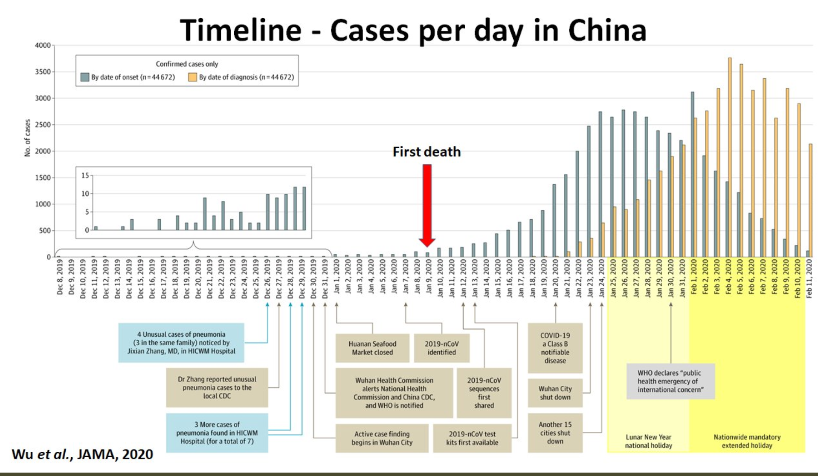
MOAR Coronavirus! II
China Beat It!
Shut down Wuhan when 200 cases per day
That seems to have been a good decision

Slide 4

MOAR Coronavirus! III
When Is It Appropriate to Move on This?
Immediate social distancing…
Self-isolate if you have a cough and a fever…
Hope that warmer temperatures will do to this what they did to SARS…
Otherwise, when do you want to start spreading out transmission. It seems that early is as good as later…

Slide 5
About the Course
The long 20th century will in all likelihood be seen in the future as the watershed in human experience:
Nine aspects:
History was primarily economic—and that was true for the first time…
Explosion of wealth: 2%+ per year…
Cornucopia of technology…
Demographic transition…
Feminist revolution…
Empowered tyrannies…
Wealth gulfs…
Inclusion and hierarchy attenuation…
Mismanagement and insecurity…
The global public health system and global epidemic transmission
Humanity is unlikely to see as transformative—for good and ill, but mostly for good, so far at least, I think—a century again…

Slide 6
U.C. Berkeley: Economics 115: Spring 2020
20th Century Economic History: Lecture 14: Really Existing Socialism Ends
Brad DeLong
Department of Economics & Blum Center, U.C. Berkeley; & WCEG
delong@econ.berkeley.edu
last revised: 2020-03-24
for delivery: ???
<https://bcourses.berkeley.edu/courses/1487684>
<https://github.com/braddelong/public-files/blob/master/econ-115-lecture-14.pptx>

Slide 7
Takeaways from Last Time
From: Social Democracy’s High Tide and Ebb
Come up with your own five takeaways from our look at the “Social Democracy’s High Tide and Ebb”…

Slide 8
Preview
Really Existing Socialism’s Ebb
Takeaways from Last Time
Preview
Administration
Lecture
Review: ??
Takeaways from this Lecture

Slide 9

Really Existing Socialism’s End
Russia Sits Down:
Pick up the story after World War II and after the death of Josef Stalin, when Russia sits down…
By 1960, a roughly First World level of health, education, and other social indicators:
However, followed by a relative decline.
And never attained a first-world material standard of living
Why did Russia sit down?
1:30

Slide 10
Bureaucracy and Central Planning
The most fundamental cause was nailed at the very birth of the Soviet Union:
German sociologist Max Weber:
“History shows that wherever bureaucracy gained the upper hand, as in China or Egypt, it did not disappear. A progressive elimination of private capitalism is theoretically conceivable. What would be the practical result? The destruction of the [dehumanizing] steel frame of modern industrial work? No! Simply that also the top management of thesocialized enterprises would become bureaucratic.
‘There is even less freedom, since every power struggle with a state bureaucracy is hopeless. State bureaucracy would rule alone if private capitalism were eliminated. The private and public bureaucracies, which now check one another to a degree, would be merged into a single hierarchy. This would be similar to the situation in ancient Egypt, but it would occur in a much more rational[ized]-and hence unbreakable-form.
“[Bureaucracy] together with the machine is busy fabricating the shell of bondage which men will perhaps be forced to inhabit as powerless as the fellahs of ancient Egypt. Who would want to deny that such a potentiality lies in the womb of the future?
This was written back in 1917
Weber was right
2:00
Notes:
One person who saw this most clearly what was to come from the Soviet Union and really-existing socialism was the German classical liberal Max Weber.:
>History shows that wherever bureaucracy gained the upper hand, as in China or Egypt, it did not disappear. A progressive elimination of private capitalism is theoretically conceivable. What would be the practical result? The destruction of the [dehumanizing] steel frame of modern industrial work? No! Simply that also the top management of the socialized enterprises would become bureaucratic.
>There is even less freedom, since every power struggle with a state bureaucracy is hopeless. State bureaucracy would rule alone if private capitalism were eliminated. The private and public bureaucracies, which now check one another to a degree, would be merged into a single hierarchy. This would be similar to the situation in ancient Egypt, but it would occur in a much more rational[ized]—and hence unbreakable—form.
>[Bureaucracy] together with the machine is busy fabricating the shell of bondage which men will perhaps be forced to inhabit as powerless as the fellahs of ancient Egypt. Who would want to deny that such a potentiality lies in the womb of the future?
This was written in 1917.
Weber was right. From the perspective of 1990 when the Soviet Union fell or of today in 2020, there is little to add. One slogan of the turn of the century American labor movements was “one big union”. The slogan of twentieth century socialism might as well have been “one big bureaucracy”.

Slide 11
Bureaucratic Centralization, Terror, and Inefficiency
But Weber had no inkling of the bloody hands that really existing socialist regimes would turn out to have:
For that we need to turn to Red Rosa—Rosa Luxemburg:
“Without general elections, without unrestricted freedom of press and assembly, without a free struggle of opinion, life dies out in every public institution…. Only the bureaucracy remains…. A few dozen party leaders of inexhaustible energy and boundless experience direct and rule…. An elite of the working class is invited from time to time to meetings where they are to applaud the speeches of the leaders, and to approve proposed resolutions unanimously–at bottom, then, a clique affair…. Such conditions must inevitably cause a brutalization of public life: attempted assassinations, shooting of hostages, etc…
Plus inefficiency:
Without the “where should resources move?” signals of prices
Without the “this organization needs to shut down” signals of bankruptcy
1:45
Notes:
Weber had no inkling of the periodic waves of mass terror required to preserve Communist Party power in the face of the enormous gap between the party's official ideology and its actual practice. In fact, socialism turned out in the direction that but much worse than Weber had anticipated beforehand. For that we have to turn to Rosa Luxemburg—Red Rosa, murdered by the German social democratic government in 1919:
>Without general elections, without unrestricted freedom of press and assembly, without a free struggle of opinion, life dies out in every public institution…. Only the bureaucracy remains…. A few dozen party leaders of inexhaustible energy and boundless experience direct and rule…. An elite of the working class is invited from time to time to meetings where they are to applaud the speeches of the leaders, and to approve proposed resolutions unanimously—at bottom, then, a clique affair…. Such conditions must inevitably cause a brutalization of public life: attempted assassinations, shooting of hostages, etc…
And neither saw the inefficiency produced by the absence of market signals—the “where should resources move?” signals of prices, and the “this organization needs to shut down” signals of bankruptcy.
Weber thought really-existing socialism would be regimented and organized—but efficient. Luxemburg thought it would be brutal and dictatorial—but efficient. Neither saw the waste, the lines, the irrationality of economic organization and the degree to which things would run off of corruption, influence, and networks: blat. _

Slide 12
Outside Images of the U.S.S.R.
In the 1920s and 1930s, focusing on accomplishments and explaining away deficiencies:
Outsiders focused on:
Elimination of unemployment
Rapid expansion of industrial production
Blaming deficiencies on bad historical starting point
Continuation of trends found in the rest of the world—monopoly capital
Insiders focused on: U.S.S.R. as natural development of global trends as well
Lincoln Steffens: “I have seen the future, and it works.”
John Maynard Keynes: “I should like to give Russia her chance; to help and not to hinder. For how much rather... if I were a Russian, would I contribute my quota of activity to Soviet Russia than to Tsarist Russia!… Eyes were turned towards, and no longer away from, the possibilities of things…”
4:00
Notes:
Outside Images of the USSR: Images in the 1920s and 1930s
The reality of the Soviet Union in the 1930s was in strong contrast to the image that many outside had of it. Outsiders focused on three things. First, the Soviet Union had eliminated unemployment—in a decade in which unemployment was bitter and pervasive outside of Russia. Second, Soviet production was expanding rapidly—in a decade in which production stagnated elsewhere in the world. Third, shortcomings in the Soviet Union could be blamed on the past: the country’s backwardness, the heritage of the Czars, the necessity of doing everything as fast as possible to strengthen the country and catchup to the advanced industrial powers. “You can’t make an omelette without breaking eggs.”
And, fourth, outsiders also focused on how the Soviet Union seemed to many to exhibit in extreme trends that were being found all over the industrialized world. Had not the years leading up to 1929 seen the increased monopolization and concentration of the economy? Were not the largest firms in 1929 bigger than whole economies had been half a century earlier? Did not major investment banking firms like J.P. Morgan and Company (in the U.S.), the Deutsche Bank (in Germany), or the Yasuda zaibatsu (in Japan) exercise a remarkable amount of command and control over the economy’s large-scale investment decisions? As Vladimir Lenin had written during World War I:
>When a large enterprise… on the basis of exact computation of mass data, organizes according to plan the supply of primary raw materials to the extent of two-thirds or three-fourths of all that is necessary for tens of millions of people; when the raw materials are transported to the most suitable place of production, sometimes hundreds or thousands of miles away, in a systematic and organized manner; when a single center directs all the successive stages of work… then it becomes evident that we have socialization of production… that private economic relations and private property relations constitute a shell which is no longer suitable for its contents… [and] which will inevitably be removed…
Yes, the Soviet Union exerted a definite attraction on leftists and non-leftists alike.
Those like writer Lincoln Steffens returned from Stalin’s Russia saying: “I have seen the future, and it works.”
And consider, once again, John Maynard Keynes, effete intellectual upper-class snob. He had many reasons to dislike Leninism and the Soviet Union:
>Brought up in a free air... Red Russia holds too much which is detestable… a creed that does not care how much it destroys the liberty and security of everyday life, which uses deliberately the weapons of persecution, destruction, and international strife... spending millions to suborn spies in every group and family at home…
He was especially annoyed by its use of Marxism:
>How can I accept a doctrine which sets up as its bible, above and beyond criticism, an obsolete economic textbook [Marx’s Capital] which I know to be not only scientifically erroneous but without interest or application for the modern world?…
Yet even he could also write:
>I should like to give Russia her chance; to help and not to hinder. For how much rather... if I were a Russian, would I contribute my quota of activity to Soviet Russia than to Tsarist Russia!//
It was tyrannical and detestable, but “eyes were turned towards, and no longer away from, the possibilities of things…

Slide 13
Images in the 1940s and 1950s
Economies of scale and the productivity of investment:
The USSR as the end stage of “monopoly capitalism”: convergence o the systems
The USSR as more efficient because able to avoid depressions and compensate for externalities
The USSR as more productive because able to mobilize investment
This belief—that the USSR might be a bad society for political and civil rights reasons, but it was going to be more productive in the end—lingered well into the 1960s
Had not the USSR won World War II through its enormous productive effort starting from a small base?
2:30
Notes:
Images in the 1940s and 1950s
Lenin—and many others—had seen socialism already fully built in the large organizations of vertically-integrated manufacturing firms and in the loose financial empires of bankers: the new economy in the womb of the old. Laissez-faire advocates had promised that the market economy could deliver. And in the 1930s it had not. It was time for socialism. And by 1945 there was a socialism up and running in the USSR. Lenin and Stalin’s brand of socialism had turned a country of peasants, animal-powered small farms, and craftsmen into a country of industrial workers, machine-powered collective firms, and factories. They had—they claimed—done in one generation the economic transformation that had taken five generations in Britain. And it was they, not the Johnny-come-latelies who has only dared put troops into northwest Europe in the final year before the Nazi collapse, who had won World War II.
Many outside the USSR—take left-wing economist Paul Sweezy, fired from Stanford for being a communist during the McCarthy era even as the establishment pontificated about the importance of maintaining academic freedom—would confidently predict that Leninist socialism and government planning would deliver a more efficient allocation of productive forces and a faster rate of economic growth than any alternative system. And many who feared Leninist socialism as destructive of human liberty, happiness, and high mass consumption agreed that the USSR and its satellites were likely to forge ahead in total and per capita production.
And even if centrally-planned economies of scale did not outweigh inefficiencies from abandoning market coordination, a centrally-planned economy would have no difficulty in attaining a high rate of investment. Paul Samuelson—no Leninist he—had the leading post-World War II American economics textbook. Up until the late 1960s its forecasts showed the USSR surpassing the American economy in production per head well before 2000. That the Soviet Union might produce superior production and equality, if not prosperity, even if inferior with freedom and choice, seemed a live possibility even into the 1960s.
——
More on Expectations of Soviet Productive Dominance
Indeed, many thought the Soviet Union was ultimately going to win the battle of production with the United States. It would be much less free. It would be a dictatorship. It would be detestable: destroying liberty and security in everyday life, using persecution, destruction, and international strife, and suborning spies in every group and family. Plus it was post-truth: telling lies that everyone knew were lies was a way of enforcing dominance: cf. Nineteen Eighty Four_, by George Orwell. But it would be able to outproduce the capitalist industrial west. One person who held this view was journalist I.F. Stone, who wrote in 1956:
This is not a good society and it is not led by honest men. No society is good in which men fear to think—much less speak—freely. I don't care how many tons of steel the Russians produce.... This society is a paradise only for a rather stupid type of Communist party member…
Why was it thought more likely to be more productive? Think of it this way: The level of technological and organizational capabilities in the Soviet Union is lower than in the United States--centrally planned economies are inefficient. As my teacher Rick Ericson wrote, the Soviet economy had to be inefficient: Prices… [were] used for measurement, accounting, and control purposes”, that is, expressly not to provide incentives. But inevitably, prices do drive people’s incentives: they thus provide information, information that is inevitably acted on, that are “irrelevant or incorrect… about relative values and scarcities”. As a result, the traditional Soviet economic system is very good at mobilizing scarce resources and concentrating on a few clear, well-defined objectives. It can succeed as long as these objectives could be expressed in measurable, quantitative, and communicable terms. It could succeed as long as plan success or plan failure produced large and very observable outcomes. It could not succeed otherwise.
However, this mode of failure would not grow in relative importance over time. The economy would be inefficient. But there would be no strong tendency for the proportional gap in technological and organizational capabilities to grow.
The Soviet Union would remain a totalitarian state. It would thus remain very good at squashing consumption, and in thus channelling extra savings into boosting the capital stock. Thus in the long run the USSR would have a higher capital stock per worker but a lower efficiency of labor. And as time passed while Soviet consumption remained depressed, it would have a much higher capital intensity, which would make it more productive—even though its people would still be very likely to lead poor and impoverished lives.
This turned out to be wrong: inefficiency in consumer goods allocation turned out to be generated by forces that also produced gross inefficiency in investment allocation as well.

Slide 14
Accomplishments of the U.S.S.R.
A substantial amount that is very impressive—especially if you take a non-North Atlantic benchmark:
Outstripped by Japan, but not otherwise…
By 1960, a roughly First World level of health, education, and other social indicators. However, followed by a relative decline.
And never attained a First World standard of living
The victory in World War II--and the heavy-industrial and military production that made this possible:
No market economy would ever have built a heavy industrial complex in Magnitogorsk.
And all praise to comrade Alexei Kosygin for the most extraordinary industrial relocation effort in history.
But Tukhachevsky would have done a lot better than Zhukov.
And if the Ukrainians had not had to learn to be anti-Nazi things would have gone much better.
Its relatively equal income distribution. Or was it a relatively equal income distribution?
The attainment of military-strategic parity with the United States in the 1970s. But what do you have to believe about the world to see that as an achievement rather than as a mistaken waste of resources?
2:00
Notes:
Especially if you take a non-North Atlantic benchmark, there is a substantial amount in the Soviet record that is very impressive—especially if you avert your eyes from the genocide, the terror, the purges, the forced labor, the dictatorship.
Outside of the North Atlantic (and Australia and New Zealand), the Soviet Union was clearly outstripped only by Japan.
By 1960, it had attained roughly First World level of health, education, and other social indicators. (However, this was to be followed by the relative decline. And it had never attained a First World standard of living.)
Moreover, it had the victory in World War II—and the heavy-industrial and military production that made this possible. No market economy would ever have built a heavy industrial complex in Magnitogorsk. And all praise to comrade Alexei Kosygin for the most extraordinary industrial relocation effort in history, moving a huge chunk of Soviet industry out of the path of the Nazi panzers and setting it up again to produce.
But the purged Marshall Tukhachevsky would have done a lot better commanding the armies than Stalin-toady Zhukov. And if the Ukrainians had not had to learn to be anti-Nazi—if they had not started out welcoming HItler on the grounds that he could not be worse than Stalin—then things would have gone much better.
The Soviet Uion had relatively equal income distribution. Or was it a relatively equal income distribution?
And it had the attainment of military-strategic parity with the United States in the 1970s. But what do you have to believe about the world to see that as an achievement rather than as a mistaken waste of resources?

Slide 15
Successes Only from a Particular Point of View
If the USSR was “non-European”, it did rather well, did it not?:
Robert Allen’s view:
Pre-October growth "a one-off resource boom with a veneer of some tariff-induced industrialization.” Russia was headed for a Latin American or South Asian destiny.
You needed a Big Push, and heavy industry was the Turnpike.
Planning could coordinate a Big Push to replicate the industrial structure you know you want to have.
Russia was saved from India's fate by a rapid demographic transition fueled primarily by the large scale emancipation of women.
Rapid industrialization driven by resource mobilization.
A post-Stalin slowdown was due to (a) the requirements of military spending and (b) "hare-brained schemes".
1:00
Notes:
Yet Soviet successes were such only from a particular point of view.
Robert Allen moves the goalposts, and points out that if one compares growth from 1917 to 1990 in the Soviet Union to growth in Latin America rather than to growth in Europe, the Soviet Union does relatively well. The problem with this, however, is that such a yardstick is not terribly natural: the Soviet Union’s neighbors closest to the overwhelming bulk of its population were Finland and Sweden, Poland and Germany, Czechoslovakia and Roumania, and Turkey.
Was Russia was saved from India's fate by a rapid demographic transition fueled primarily by the large scale emancipation of women?
Perhaps. But unlikely.

Slide 16
Resource Mobilization Is Resource Mobilization
And outside the North Atlantic, only Japan achieved even resource mobilization:
(But Japan also achieved much more)
Allen’s case again:
“[In Britain] private property and… representative government... was the basis of civil society independent of the state.... [In Russia] the "rule of law" was a tool by which the tsar and nobles exploited the peasants rather than an impartial umpire…. Tsarist Russia [thus] lacked the social, legal and economic institutions that theorists of economic growth have argued are prerequisites for capitalist development. Indeed, much of the rest of the world lacked--and still lacks--this as well...”
0:45
Notes:
There is an argument, made by economic historian Robert Allen, that the Soviet road was the only road open to Russia. The argument is worth registering. As he puts it:
>[In Britain] private property and… representative government... was the basis of civil society independent of the state.... [In Russia] the "rule of law" was a tool by which the tsar and nobles exploited the peasants rather than an impartial umpire…. Tsarist Russia [thus] lacked the social, legal and economic institutions that theorists of economic growth have argued are prerequisites for capitalist development. Indeed, much of the rest of the world lacked--and still lacks--this as well...

Slide 17
Resource Mobilization Is Resource Mobilization II
And outside the North Atlantic, only Japan achieved even resource mobilization:
(But Japan also achieved much more)
Allen’s case again:
“Two responses are possible... create the missing prerequisites... create substitutes.... Russia's path to industrial society was based on the state's creating policies and institutions to substitute.... In the absence of the communist revolution and the Five-Year Plans, Russia would have remained as backward as much of Latin America or, indeed, South Asia. That fate was avoided by Stalin's economic institutions…”
1:30
Notes:
In such a situation, Allen says:
>Two responses are possible... create the missing prerequisites... create substitutes.... Russia's path to industrial society was based on the state's creating policies and institutions to substitute.... In the absence of the communist revolution and the Five-Year Plans, Russia would have remained as backward as much of Latin America or, indeed, South Asia. That fate was avoided by Stalin's economic institutions…
Allen’s belief is that the Soviet Union brought resource mobilization and birth control—via its early introduction of much of feminism. Growth from resource mobilization is not the productivity-frontier post-industrial market capitalist development from higher productivity that has marked the twentieth century. But it is resource mobilization.
And an early demographic transition greatly reduces the burden of population growth on an economy.
The counterfactual image would then be not something like the Czech Republic, but rather something like India, as what Russia would have become had it followed a non-really-existing socialist and more “normal” road in the twentieth century.

Slide 18
Did the Soviet Union Have to Follow the Stalinist Road
Tony Judt says “yes”, and I think he is right:
Baked in the cake from Lenin’s coup
Reform not possible
Judt:
“Marx’s other youthful intuition—that the proletariat has a privileged insight into the final purposes of History thanks to its special role as an exploited class whose own liberation will signal the liberation of all humankind—is intimately attached to the ultimate Communist outcome, thanks to the subordination of proletarian interests to a dictatorial party claiming to incarnate them.
“The strength of these logical chains binding Marxist analysis to Communist tyranny may be judged from the many observers and critics—from Mikhail Bakunin to Rosa Luxemburg—who anticipated communism’s totalitarian outcome, and warned against it, long before Lenin got anywhere near the Finland Station. Of course Marxism might have gone in other directions: it might also have gone nowhere. But ‘the Leninist version of Marxism, though not the only possible one, was quite plausible’…
1:30
Notes:
Could it have been reformed?: Tony Judt: “Moreover, Marx’s other youthful intuition—that the proletariat has a privileged insight into the final purposes of History thanks to its special role as an exploited class whose own liberation will signal the liberation of all humankind—is intimately attached to the ultimate Communist outcome, thanks to the subordination of proletarian interests to a dictatorial party claiming to incarnate them. The strength of these logical chains binding Marxist analysis to Communist tyranny may be judged from the many observers and critics—from Mikhail Bakunin to Rosa Luxemburg—who anticipated communism’s totalitarian outcome, and warned against it, long before Lenin got anywhere near the Finland Station. Of course Marxism might have gone in other directions: it might also have gone nowhere. But ‘the Leninist version of Marxism, though not the only possible one, was quite plausible’…

Slide 19
Failures of the USSR
Especially if you take a North Atlantic benchmark:
The Soviet growth rate was not impressively high...
Even before 1917, the Russian economy had “taken off”…
The increased output achieved under the Communists was limited to steel, machinery, and military equipment.... The welfare of the working class... would have been better served by... capitalism....
The collectivization of agriculture... is a particularly vicious example....
Soviet socialism was economically irrational... driven by ideology, bureaucratic infighting, and despotic caprice… massive misallocation....
The growth slowdown after 1970 showed the ultimate weakness of really existing socialism:
It could function in a mediocre way to build... smokestack industries...
It was incapable of the sustained technological advance required for the postindustrial age...
1:45
Notes:
Larger and Greater Failures of the U.S.S.R. The Narrow Focus of Soviet Growth
The increased output achieved under the Communists was limited to steel, machinery, and military equipment. Surely the welfare of the working class would have been better served by capitalism? The collectivization of agriculture was a particularly vicious example: we do not know how many died. We think it was in the mid seven figures. It might have been eight figures. And the Soviet growth rate was not impressively high when seen in a European context. Even before 1917, the Russian economy had taken off.
Soviet socialism was economically irrational: driven by ideology, bureaucratic infighting, and despotic caprice. Its economic calculations were massive misallocations.
The growth slowdown after 1970 showed the ultimate weakness of really existing socialism. It could mobilize resources via command and terror. It could copy factories as long as it had foreign engineers on call to assist and advise. It could function in a mediocre way to build smokestack industries.
Now smokestack industries are good things. But a rich modern economy is more.
The USSR was incapable of the sustained technological advance required for the postindustrial age...

Slide 20
Market Organization Matters a Lot
We covered this before:
The lesson I draw from this tale is that Ukraine and Russia seriously underperformed
And much more so Lithuania, Latvia, Estonia, and Leningrad Oblast
In contrast to, say, Soviet Georgia and Kazakhstan, where a “non-European” benchmark might be (or might not be) appropriate
1:00
Notes:
We have seen this table before. Market organization matters a lot. Market organization matters 80+% in the long run.
When the Iron Curtain fell in 1990, we could compare the economic prosperity of the countries on either side of it. And the division between Iron Curtain and outside was where communist armies were lucky enough to march at the end of World War II. We do not need to worry about other factors than communist rule confounding our conclusion that the gulf was caused by really existing socialism here.
The lesson I draw from this is that Ukraine and Russia seriously underperformed relative to what would be the natural benchmark. And much more so did Lithuania, Latvia, Estonia, and Leningrad oblast underperform relative to the other Baltic Sea economies.
By contrast, you might say that Soviet Georgia and Kazakhstan, places where a non-European benchmark might or might not be more appropriate, may have suffered less, from the very narrow perspective of forgone an economic growth as a result of the rule of really existing socialism.

Slide 21
Market Organization Matters a Lot II
Rick Ericson:
“[Soviet] Prices… [were] used for measurement, accounting, and control purposes”: i.e., not for incentives.
“[Soviet] Prices provide irrelevant or incorrect information about relative values and scarcities”.
“The traditional Soviet economic system is very good at mobilizing scarce resources and concentrating on a few clear, well-defined objectives that can be expressed in measurable, quantitative, and communicable terms, and that yield large observable changes as outcomes…”
0:40
Notes:
Market organization matters a lot. To quote the first person to ever teach me economics, Rick Ericson:
• “[Soviet] Prices… [were] used for measurement, accounting, and control purposes”: i.e., not for incentives.
• “[Soviet] Prices provide[d] irrelevant or incorrect information about relative values and scarcities”.
• “The traditional Soviet economic system is very good at mobilizing scarce resources and concentrating on a few clear, well-defined objectives that can be expressed in measurable, quantitative, and communicable terms, and that yield large observable changes as outcomes…”

Slide 22
“Peaceful Coexistence”
And peaceful competition: N.S. Khrushchev:
“Must we, in this period of the flourishing of human genius which is penetrating the secrets of nature and harnessing its mighty forces, put up with the preservation of relations that existed between people when man was still a beast?…
“Time is a good adviser, or as the Russian people say, ‘Take counsel of one's pillow’. This is a wise saying….
“We shall do everything we can to tilt the barometer's hand away from ‘Storm’ and even from ‘Changeable’ to show ‘Fine’…
“I am confident, comrades, that… when the socialist camp has some one billion people and tremendous productive potential, when the Soviet Union has reached great heights in industry and agriculture, science, technology and culture, we can do a lot for the sake of peace.
“In our actions we rely on reason, on truth, on the support of all the people. Moreover, we rely on our great potential. And let it be known to those who want to continue the cold war so as to turn it sooner or later into a shooting war, that in our time only a madman can start a war and he himself will perish in its flames…”
2:00
Notes:
N.S. Khrushchev seized control of the Soviet Union in 1956 after the death of Stalin, and dialed down the paranoia. He reigned until 1964.
Khrushchev believed that the Soviet union was or could become a better system. He believed that history was on his side. He believed it all he had to do was build up the Soviet Union economy, society, and culture, and avoid both a major war that would be a catastrophe for the world, while also deterring minor wars in which the capitalist imperialists nibbled away at the edges or prevented the natural growth of the socialist camp as more and more people saw it as the better wave of the future.
Then, K. thought, Soviet victory in the Cold War would be natural, inevitable, and easy.
Khrushhev is, I think, worth quoting:
>“Must we, in this period of the flourishing of human genius which is penetrating the secrets of nature and harnessing its mighty forces, put up with the preservation of relations that existed between people when man was still a beast?…
>“Time is a good adviser, or as the Russian people say, ‘Take counsel of one's pillow’. This is a wise saying….
>“We shall do everything we can to tilt the barometer's hand away from ‘Storm’ and even from ‘Changeable’ to show ‘Fine’…
>“I am confident, comrades, that… when the socialist camp has some one billion people and tremendous productive potential, when the Soviet Union has reached great heights in industry and agriculture, science, technology and culture, we can do a lot for the sake of peace.
>“In our actions we rely on reason, on truth, on the support of all the people. Moreover, we rely on our great potential. And let it be known to those who want to continue the cold war so as to turn it sooner or later into a shooting war, that in our time only a madman can start a war and he himself will perish in its flames…”

Slide 23
Kosygin: Economic Reform
N.S. Khrushchev the last true believer; Kosygin the last worker-bee:
After Kosygin, time-serving bureaucrats going through the motions
Until Gorbachev, and his attempted reforms in the 1980s
Kosygin as the logistical architect of victory in World War II
Kosygin as first among three after 1964
Kosygin’s recognition of the need for reform
How do you introduce more rational decision making into a planning bureaucracy?
If all that matters is that Maginitogorsk produce as many tanks that will start up and fire at least one round, you can do that:
Tanks last for only 14 hours in combat, anyway—and for six months max during wartime
Command the big flows of raw material
Require that the managers buy, beg, borrow, steal, and trade for the rest of what they need—threatening to tell the higher-ups who is uncooperative
Show the final output
Not a way you can run a complex, modern economy
Even Cuba’s 10 million ton sugar harvest
But can you be a little bit market?
The China Road, or nothing
7:30
Notes:
Soviet Union paramount leader Nikita Khrushchev, who ruled from 1956 to 1964, was the last true communist. He the last who was certain that the Soviet union was the wave of the future and the road to Utopia. Aleksey Kosygin, by contrast, was hopeful, But he knew something about the economy and economics. He believed that the triumph of socialism on the level of production and living standards would require a lot of hard work.
During World War II Kosygin had managed the move of the Soviet industry out of territories soon to be overrun by the Nazi Army: an extraordinary managerial accomplishment, and one about which I know much too little. By March 1959 Kosygin had been promoted to run the Soviet Union’s State Planning Committee. In 1964 Nikita Khrushchev was removed from office: In the judgment of his colleagues, he had tried to implement too many unsuccessful “hair-brained” scheme’s.
Kosygin, Leonid Breznitz, and Nikolai Podgorny then formed a triumvirate to rule the Soviet union. However, previously, all attempts at collective rule had proven unstable. This triumvirate was to be no exception.
Initially, in the latter half of the 1960s, Kosygin was the most prominent figure. He ran the economy. He ran arms control talks with the US. He was responsible for relations with Eastern European satellites.
However, the Prague Spring in 1968 resulted in a severe backlash against him: Too reformist, too soft, two willing to question the system—and the fact that the Communist Party of Czechoslovakia had attempted to move away from the Soviet model showed that a stricter lockdown was necessary. By 1971 it was “the Politburo led by Brezhnev”, and Kosygin was in eclipse.
Before his eclipse, however, Kosygin had recognized that the Soviet economy was in trouble, and attempted its reform.
The reformers’ belief was that the increasing complexity of economic relations was greatly reducing the effectiveness of the existing system of planning. It did not provide incentives to produce goods of high-quality, or to produce them efficiently. It, rather, focused attention on achieving one target and one target only: for example, the number of T-34 tanks that could start up and shoot at least one round when they came off the assembly line. All else was subordinated to achieving the single quantitative metric that the planners could see and focus on.
With respect to Magnitogorsk’s production of T 34C tanks, the center can command Magnitogorsk to receive big flows of raw materials. The center can require that managers beg, buy, borrow, steal, and trade for the rest of what they need, all the while threatening to tell the higher-ups who was uncooperative with them and impeded the plan. The managers can then show the final output: the tank starts up, drives off the assembly line, and shoots a round. That the tank is a piece of crap as far as its quality is concerned is not a problem: The tank will only last for 14 hours in battle before the Nazis destroy it. And it will certainly be committed to a campaign in which it will see those 14 hours of battle before it has time to rust for more than six months.
But that was no way to run the railroad that was a much more complicated, much more differentiated, modern economy.
In the middle of the 1960s, Fidel Castro and Che Guevara were in charge in Cuba. They decided they wanted to make Cuba richer. Cuba exported sugar. Sugar was a high priced commodity on the world market. They decided that if they could make Cuba export 30% more sugar, they would have many more resources to grow the Cuban economy.
So they called for a 10,000,000 ton annual sugar harvest.
In order to achieve that harvest, they tried to borrow from the Soviet tradition and from the Maoist tradition as well: They laid out a plan for planting getting the machetes into the cane fields and then for transporting the cane to the factories. They called upon the people of Cuba to make a great effort for the common good and put down their usual tools so they could go into the sugarcane fields, pick up the machetes, thus providing the extra labor force needed to cut the harvest produced by the extra-thick and extra-extensive plantings.
Did it work? No.
Sugarcane is more complicated then steel.
It has to be cut at the right time, when it is ripe. And unskilled workers fresh from the cities do not know when it is ripe. It’has to be stacked and transported quickly to the factories, before the sugar rots away. Extra drivers brought into the fields have no clue. They do not understand the necessity. Their livelihoods do not depend on the cane being high-quality when it arrives at the factory door. So they see little reason not to idle and delay.
If you want to push decision making out to the periphery where the information is, and if you want managers who know what is going on to make decisions that involve tradeoffs among which good things to produce and which resources to use to produce them, then there are requirements. They have to take the prices they face—not the commands of the ministry—seriously, and that means that the prices they face have to be ones that correspond to societal utility, not ones that get applause from bureaucrats when they are set at particular values.
And if you give managers the freedom to set their own prices, you need to be sure that there is no monopoly power in the system.
Thus the answer to “can you be just a little bit market?” is, inevitably, “no”.
The problem for Kosygin, and for the Soviet Union, was that his reforms involved re-introducing elements of the market system into the Soviet economy. And in the end his colleagues in the bureaucracy reacted the conclusion that it just could not be done. You cannot be just a little bit pregnant: you could not have a system that was mostly central planning, with a little bit of market allocation.
You can go full-hog with reform. You can take the China road. Proclaim Deng Xiaoping’s “to get rich is glorious”. Turn your local government officials into a full-fledged business class, by assisting them in starting township and village enterprises. Then the profits can be devoted to accomplishing local projects that please higher-ups. Then the managerial jobs in the enterprises can be allocated to smart clients and relatives who need careers. Then the demand by the TVEs can be channeled to private startups in which local officials and party bosses have substantial silent ownership interests. And at the end of the process you have socialism with Chinese characteristics—or rather state capitalism with Chinese characteristics and some socialist utopian aspirations.
Or you can stick to bureaucratic central planning, with its inefficiences kept from causing the economy to freeze-up completely by making ad hoc adjustments through patronage networks and via corruption.
You cannot stop halfway.

Slide 24
The Course of 1960s and 1970s Soviet Reform
Evsei Lieberman’s proposals:
Five elements
Rewarding profitability
Rational price-setting
Enterprise decision-making
Light hand from the ministry
Largely reversed in 1969-1971
The Prague Spring and Kosygin’s relative eclipse
Military requirements
Backward agriculture
4:30
Notes:
Economist Evsei Lieberman had already been allowed in 1962 to publish in Pravda an article arguing for the re-introduction of profitability as a key economic indicator: workers and managers should be materially rewarded if their enterprises were profitable, and materially sanctioned if their enterprises were not. If it is productive and useful for society, Lieberman argued, the government should make it profitable for the enterprise. And then, having set prices appropriately to correspond with societal values, the government could step back and no longer issue inefficient and often nonsensical commands.
The reforms that Kosygin attempted to introduce had four major elements:
First, firms would be rewarded if they were profitable. A fraction of the extra profits would then be earmarked for the business, for it to use to acquire capital equipment, acquire better housing for its workers, spend on bonuses for workers, or spend on other government-approved uses.
A second was that the government should reset wholesale prices so that the prices were realistically tied to actual costs to society.
A third was that enterprises were required to make their own decisions: determine what and what kind and what exact variety of things they would produce, determine how many workers to hire, and set up their own long-term relationships with upstream suppliers and downstream customers.
And, fourth, the number of policy targets that an enterprise had to report to its ministry (and explain if it failed to meet them) was reduced from 30 to 9.
By the end of 1966, more than 700 enterprises comprising some 20% of the economy were on the new system. By the end of 1968, it was nationwide.
Up until then, managers had followed a standard game: underestimate your resources and productive capacities during the planning stage, so that your targets are set low enough that you can overfulfill them in the implementation stage. The new system confused them.
Moreover any system that proposes to remove power to control and extort from bureaucrats is going to face obstacles. Ministry officials continued to issue commands that they were not supposed to to enterprise managers—and they still decided on what the enterprise managers’ next postings would be.
Wholesale metal ore and hydrocarbon fuel prices went way up. Consumers found themselves paying higher prices, for firms introduced new expensive and withdrew old cheap models that did not enhance their proofitability. Yet the pace of economic growth picked up. In retrospect, 1966-1970 was the golden age.
However, the central planners were not satisfied. Kosygin lost influence with Czechoslovakia’s drive to create “socialism with a human face”, and with the subsequent Soviet military overthrow of the government. Many reforms were reversed. Kosygin, now in a secondary position, pushed on. He demanded that the Ninth Five Year Plan increase the Soviet consumer standard of living by 50%. It did not.
Kosygin proposed that the Tenth Five Year Plan of 1976-1980 be a “plan of quality” and focus on further expanding production of consumer goods. Brezhnev vetoed it: in his view, for 25% of industrial production to be devoted to consumer goods—with the rest devoted to investment goods, and the military—was more than enough. Kosygin lamented that the requirements of the military would be the grave of the Soviet economy, and lead it to ruin.
One-third of all investment was devoted to agriculture—ten times its share of the Soviet economy. Agriculture had emerged as the most backward and inefficient sector in the USSR. Odessa had exported more grain than any other port in the world before 1914. But by the end of the 1970s the USSR could not produce enough of staple grains to feed itself.

Slide 25
And in the Late 1980s It Came Tumbling Down
Yegor Gaidar’s view: wheat and rye, and oil, in the 1970s and 1980s:
First, back up to 1928-9: the “scissors crisis” and its consequences
The enserfment of the peasantry in collective farms
Low productivity
Stagnant grain harvest
Khrushchev tried to throw investment resources at the problem
The striking contrast between the grain-exporting Russian Empire and the grain-importing USSR
What could the USSR sell?
Not manufactures
Oil and natural gas
2:45
Notes:
Yet in the late 1980s it all came tumbling down. Soviet General Secretary Mikhail Gorbachev decided to try to reform the system. And intead of being reformed, it collapsed.
The late Yegor Gaidar liked to tell the story of the collapse through the lens of oil and wheat—two key commodiites in the economy of the Soviet Union
But first, back to 1928 and 1929. Back then, as Gaidar put it:
>Bukharin and Rykov essentially told Stalin: ‘In a peasant country, it is impossible to extract grain by force. There will be civil war’. Stalin answered, ‘I will do it nonetheless’.
As of 1950 Khrushchev was dealing with the consequences of the backward, enserfed agricultural sector of collective farms managed by party bosses controlling workers who had little stake in productivity or production that Stalin had created. We think that 25% of Soviet agricultural output came from the 2% of the land that the collective farms allowed their workers to grow and sell on their own.
And as of 1950, Khrushchev was writing:
>In the last fifteen years, we have not increased the collection of grain. Meanwhile, we are experiencing a radical increase of urban population. How can we resolve this problem?
The decision made, implemented under Khrushchev’s rule, was to throw resources at the problem: large projects and a tremendous extension of land put under wheat and rye cultivation. It did not work. In 1963 the USSR informed its allies that it would no longer be able to ship them wheat and rye. In 1965 it began to buy wheat and year on the world market. And after 1970, wheat and rye prodcution in the Soviet Union was stagnant: year-to-year fluctuations around 65 million tons per year that was the harvest.
Russia before World War I had been the world’s largest wheat exporter, and Odessa the world’s largest wheat export port. The post-1970 Soviet Union became the world’s largest wheat importer.
How to pay for food imports? Russian military hardware could not be sold to wheat and rye exporting nations, even had they wanted. And other Russian industrial production was of too low quality to be attractive to buyers abroad in Canada and the United States. But the USSR had to pay for its grain by selling something. And it did have oil and natural gas surplus to its needs.

Slide 26
Subject to the Whims of OPEC
Global oil prices tripled in the 1970s:
Did this save the USSR for a decade?
The USSR did manage to put bread on the shelves of the stores
If it had not managed to reliably put bread on the shelves, would it have fallen a decade earlier?
Or did the fact that it could buy grain keep it from a “Chinese reform” until it was too late?
Was a “Chinese reform” of the collective farms possible?
Saudi’s decision to cut world oil prices in three in late 1985 caused a crisis
Soviet solution? Borrow
2:45
Notes:
Thus the post-1970 Soviet economy’s ability to feed its people with staple wheat and rye bread on the shelves hinged on its ability to earn hard currency by exporting oil and natural gas. It may be that the collapse of the Soviet economy and the Soviet model was delayed for a decade by the more-than-tripling of world real oil prices during the OPEC decade of the 1970s. For the western Siberian oil and gas fields came through—although the Soviet Union could not calculate whether its concentration of resources on their exploitation was economically productive in the long run or not.
Did this save the USSR for a decade? The USSR did manage to put bread on the shelves of the stores. If it had not managed to reliably put bread on the shelves, would it have fallen a decade earlier? Or did the fact that it could buy grain keep it from a “Chinese reform” until it was too late? And would a late-Kosygin “Chinese reform” have gotten Kosygin the trust and political capital Deng Xiaoping’s dissolution of the collective farms won for him? Or was Soviet agriculture too mechanized for a return to peasant farming to have been productive? Deep questions I do not know the answer to.
Yegor Gaidar certainly traced the collapse of the Soviet Union to the Saudi decision at the end of 1985 to resume pumping oil at capacity, and thus to crash the price of oil, largely to curb the ambitions of Iran’s theocrats.
How was the Soviet Union to respond? Stop supplying its eastern European satellites with hydrocarbons? Cut domestic grain rations and supplies substantially? Shift industrial production from the military to export manufactures?
The Soviet Union had no competence to do the third.
Its leaders did not believe it could, politically, survive the second.
And the first meant total ideological defeat: giving up the prizes won from the sacrifices of World War II.
As Gaider assessed the situation, the Soviet Union started to borrow in 1986.

Slide 27
The Money Ran Out
Too late for a Chinese-style agricultural reform—even if it would have worked:
Deutsche Bank’s warning: western banks were too nervous to lend more
The requirement that they turn to western governments for “politically motivated credits”
Put the loaves of bread on the shelves reliably only by bargaining away political concessions in return for wheat subsidies
Revelation of the underlying rigidity and poverty of the system
Abandonment of Eastern European hardline communists in order to keep bread on the shelves
But how would the Soviet Union then reform itself?
3:00

Slide 28
Mikhail Gorbachev to Boris Yeltsin
Gorbachev to Yeltsin:
The perceived need to reform the system…
Mobilize the people against the party to make the party knuckle under
“Glasnost” and “perestroika”—“openness” and “reformation”
Not the China model
Deng Xiaoping’s long march—agriculture-TVEs-state capitalism with Chinese characteristics and utopian socialist aspirations
But no alternative set forward for perestroika—reformation
The coup
The collapse of the Soviet Union
4:45
Notes:
The last general secretary of the Communist Party of the Soviet Union was Mikhail Gorbachev. He was relatively young when chosen: not one of the gerontocrats of the Brezhnev era. He had a good reputation as a friendly glad-hander and an excellent manager. He had won a reputation as a guy who could make the trains run on time, for he could keep all the people under him pulling in harness.
But he was also thought to be tough enough for the job in a situation in which the party bosses understood they were in trouble and were seeking a leader, a boss: "a bright smile, but his smile shows iron teeth" was how Gorbachev was described. And the party bosses who chose him hoped he would save them, somehow.
Gorbachev came early to the conclusion that it was the party itself that was the principal obstacle to reform. Party members and party bosses had relatively cushy positions in the Russia of really existing socialism. The system ran off of networks of patrons and clients, networks of bribees and bribers, commands from above that pretended to have relevance to the economic situation on the ground and messages from underlings pretending to obey—and all the while a combination of commands, redistributions, purchases, bribes, beggary, and favors offered, received, called in, and extracted kept the system bumping alone. But any reform would disrupt these webs of licit and illicit social network transactions that were the basis for the social power of the nomenklatura: those on the list of those worthy for positions of authority.
Gorbachev’s central idea was to rally society and society’s demand for reform to overawe the party. There would be glasnost: free discussion and debate, about what had gone wrong, where the system was inadequate, and about how to fix it. That process of glasnost would lead to a societal consensus, led by Gorbachev, as to how to undertake perestroika: restructuring and reform. The party bosses would then have no choice but to acceded to the reform plans of the charismatic Gorbachev.
The problem was that Gorbachev never had any sense of what form perestroika could possibly take.
In China, Deng Xiaoping did have a sense. Start by dismantling the party official-bossed collective farms and returning the land to the peasants. Chinese agriculture at the end of the 1970s was not that mechanized—it was still mostly done by hand. Dissolving the collective farms was easy. You then immediately doubled the standard of living of the peasants and increased agricultural production by more than 50%. Much richer peasants in the countryside, cheaper staple rice and wheat in the cities, and a renewed flow of high-quality market garden produce and meat from farms near the cities. Those would win enormous political credit for a régime that was perceived as a new broom—even though, before his purging in 1966, Deng Xiaoping had been among the oldest of old brooms.
But then Xiaojing understood the most important thing: for China since 1975, the most important thing about the cat is not whether the cat is white or red, the most important thing is whether the cat fails or succeeds in catching the mouse.
Then you use government revenues to keep the old central planning industrial apparatus on life support, while you use the TVEs as your motor of economic growth in a way very pleasing to the party cadres. You bet that growth will be fast enough that in the end the subsidies to the inefficient central planning industrial apparatus will not be an unsustainable load. And at the end you have turned your nomenklatura into a bourgeoisie. And at the end your long march through agriculture and TVEs has produced state capitalism with Chinese characteristics and utopian socialist aspirations
In China it worked.
In Russia it might well not have worked.
But in Russia it was never tried.
And nothing else was tried, for there was no consensus from below and no plan from above.
In the end Gorbachev was overthrown in a coup. Yeltsin led a demonstration in Moscow. The coup plotters lost their nerve—or perhaps found that they did not have police support. The Soviet Union collapsed. And Boris Yeltsin took over in Russia.

Slide 29
Boris Yeltsin in Power
The nomenklatura still in control shaped everything:
The necessity for decontrol
Or send the Red Army into the countryside to collect the harvest
Dismantling the really existing socialist division of labor
Russian national income $21,000 per capita in 1989
Russian national income $14,000 per capita 1994-1999
State enterprises—given freedom
Nomenklatura given freedom to start up their own enterprises
“Tunneling”
Voucher privatization
But: high unemployment gives workers with their vouchers little bargaining power
Loans-for-shares
Yeltsin’s choice of Putin
Oil price boom: from $20 to $50 to $90 and back to $50/barrel
4:30
Notes:
Outside of the former Soviet Union, the end of really existing socialism saw the former nomenklatura no longer in dominant control. Inside the former Soviet Union, the former nomenklatura were still in control. And that shaped everything.
Boris Yeltsin’s first decision was to recognize necessity: to decontrol agricultural prices, and radically move to a market economy. It was, as Gaidar told me, either that or send the Red Army into the countryside to collect the harvest at gunpoint. Staliin had done that. It had not worked out well. It was better to try something else.
But the rapid move to a market economy involved the unwinding of the favor- and network-based division of labor that the Soviet economy had possessed, while attempting at the same time to build up a market-economy division of labor while the wrecking was ongoing. This was not easy to do. Measured in constant dollars of 2011’s purchasing power, the annual real GDP of the Russian Federation fell from $3.2 trillion—about $21,000 per capita—in 1990 to $2.1 trillion—about $14,000 per capita—in 1994, and then was still only $2.1 trillion in 1999. Half of this decline was a decline in the military.
You can argue that improved efficiency in allocating goods to those who valued them made up for the decline. But if you do that, you also have to recognize that a sharp increase in inequality greatly reduced any utilitarian estimate of societal wellbeing. Russia, in what counts for people, was 20% poorer from 1994-1999 than it had been under Gorbachev.
Moreover, the swift movement to a market economy gave state enterprises freedom. But state enterprises were still bossed by ex-nomenklatura members. The obvious thing for an ex-omenklatura member who bossed a state company to do was for him to start up a private company that he owned on the side, and then for him to give everything of value from the company he managed to the company he owned.
Could this process of the expropriation of the state sector have been stopped? The Chinese Communist Party retained control and authority over the managers of the state sector. But Boris Yeltsin had no such levers of control.
The hope was for voucher privatization: transfer ownership of Russian enterprises to the people at large, and then let shareholders elect boards of directors that would control and curb the tunneling of productive resources into the hands of the ex-nomenklatura. It did not work. The people who served on boards of directors were still enmeshed in their favor networks: you let me tunnel valued property out of the enterprise I run and I will let you tunnel valued property out of the enterprise that you run. And the dismantling of the really existing socialist division of labor generated high unemployment: if you wanted to keep your job, it was wise to sell your voucher privatization shares to your factory boss at an attractive price.
The nadir was reached in loans=for-shares: the transfer of the crown jewels of ownership of the Russian economy to a small group of plutocrats in exchange for their support for Yeltsin’s reelection. The U.S. Treasury protested: bad economics, bad political economy, bad politics, and short-sighted to boost. The US State Department believed that the United States had few levers, and should definitely not threaten to cut off subsidies to Yeltsin. And U.S. President Bill Clinton had bonded with Yeltsin: one charismatic and undisciplined politician understanding another one's limited room for maneuve,r and being willing to cut him some slack.
Russia at the end of the Yeltsin years was extremely unequal and quite poor. And Yeltsin decided that the country needed at its head an ex-KGB agent who could boss the plutocrats: Vladimir Putin. Putin took control just as Russia was about to realize the bonanza of rising energy prices: oil that had averaged $20/barrel over Yeltsin was to average $50/barrel over Putin’s first decade in control, and then $90 for the first half of his second decade before its fall in 2015 back to $50.

Slide 30
Vladimir Putin
Weimar Russia
From Crony Capitalism to State Capitalism:
State ownership increasing in the “commanding heights”: energy, media (propaganda), finance
Construction, transportation, high-tech in hands of partners
Strategic energy exports as instruments of foreign policy
Deliver higher living standards by redistributing wealth from the energy boom
The concentration of wealth has increased
An “assertive” foreign policy—a Monroe Doctrine for the Near Abroad
Nevertheless: Muscovy, not the East Bloc or even the Russian Empire of Tsar Aleksandr in 1815
Lack of structural reform
Net Russian real GDP growth since 1990: $26,000 today as opposed to $21,000
But, for consumers, $16,000
4:15
Notes:
Bouyed by higher oil price—up from $20 a barrel to $50 a barrel, and then $80, and then back to 50 again —Putin’s Russia has become considerably richer than Boris Yeltsin's or Mikhail Gorbachev's Russia. Russian real national income today is something like $26,000 per capita, as opposed to $14,000 per capita under Yeltsin, and $21,000 per capita under Gorbachev. Figure that, with the Soviet Union’s superpower level of military spending, and the really existing socialist level of allocative inefficiency, the 21,000 per capita under Gorbachev was probably worth only 16,000 or so. Russia today is richer then under communism.
Russia today is also an example of a form of political economy that we thought was dead. We might as well call it what people called it in the 1930s, and what Mussolini who founded this form called it: fascism.
Under Putin, Russia has moved from crony capitalism to state capitalism: plutocracy controlled by the state and managed via a leader focused on national self-assertion and creating national pride.
The state owns and controls increasingly the commanding heights of the economy: finance, energy, and media for propaganda purposes. The state makes sure that other important key sectors—construction, transportation, high-tech—are in the hands of reliable partners, and partners who are not reliable wind up in jail, or dead.
Under Putin, strategic energy exports are used as instruments for foreign policy. Higher living standards have been delivered to the people by redistributing wealth from the energy boom. The concentration of wealth has increased still further. And popular approval has been sought via an assertive foreign policy—the conquest of the Crimea, an attempt to establish a Monroe doctrine for the "near abroad" of those countries within the boundaries of the former Soviet Union, and more recently an attempt to project Russian power still further.
Nevertheless, Putin's Russia is not the world-shaking ideological and military power of Stalin or even of Brezhnev. It is Muscovy, not the Communist East Bloc, or even the Russian Empire of Tsar Alexander in 1815.
The lack of structural reform to drive economic growth, a large-scale emigration of skilled and educated workers, and a plutocracy that now fears being creatively destroyed—these are all hobbling Russia's economic growth. And many believe that the stability of Putin’s regime will come under strong threat from anything that significantly reduces the value of its oil exports.
Nevertheless, it is a “Weimar Russia”—and thus a danger totrhe world.
Back in the 1990s, with the rise of the BJP party in India and with China's increasing nationalist assertion, I used to say that I feared three things as far as world geopolitics was concerned: Wilhelmine China, National Hinduist India, and Weimar Russia. Wilhelmine China was by analogy with the German Empire of the early 1910s: a country with an upper class that had lost its societal role and that sought to distract people from the upper class’s parasitic nature by making enemies abroad and then asserting itself against it. National Hinduist India was by analogy with Germany’s Third Reich of the 1930s, with the Muslims of India cast in the role that the Nazis cast Germany's Jews.
Weimar Russia was by analogy with Germany in the 1920s: a country that had lost an international struggle but, rather than being welcomed and aided by the world community, and so assisted in its tasks of societal development, was or saw itself as treated as a pariah state by others who did not give it proper respect and assistance.
We have National Hinduist India today.
And we have Weimar Russia in spades.

Slide 31
Readings
Three key readings:
Robert Allen (2011): The Rise and Decline of the Soviet Economy http://tinyurl.com/dl20161210v
Richard Ericson: The Classical Soviet-Type Economy: Nature of the System and Implications for Reform http://tinyurl.com/dl20161210ab
Simeon Djankov (2015): Russia's Economy under Putin: From Crony Capitalism to State Capitalism http://tinyurl.com/dl20161210ad

Slide 32
Review: Broad Sweep
What was the growth rate of ideas in the industrial core of the world economy over 1870-2020?
About 2.3%/year
About 0.9%/year
About 0.23%/year
About 4%/year
None of the above

Slide 33
Review: Broad Sweep
What was the growth rate of ideas in the industrial core of the world economy over 1770-1870?
About 2.1%/year
About 0.45%/year
About 0.15%/year
About 0.04%/year
None of the above

Slide 34
Takeaways from This Time
Really Existing Socialism’s End
Give me five takeaways…

Slide 35
Notes: What Was Unconvincing Today?
Mistakes and unclarities: typos, wordos, and mindos…
In the DRAFT textbook?
In the lecture?

Slide 36
Catch Our Breath…
Ask a couple of questions?
Make a couple of comments?
Any more readings to recommend?

Slide 37
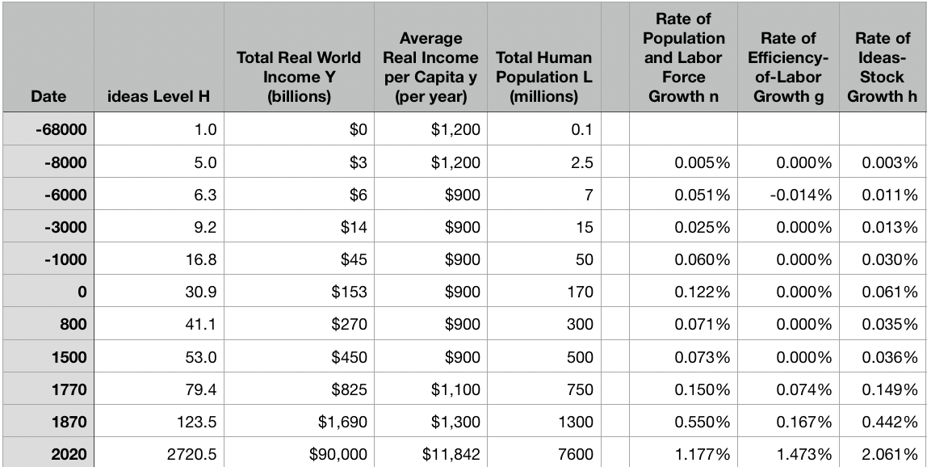
Reviews
Post-1870 is the miracle:

Slide 38
Review: The Broad Sweep
Post-1870 is the miracle:

Slide 39
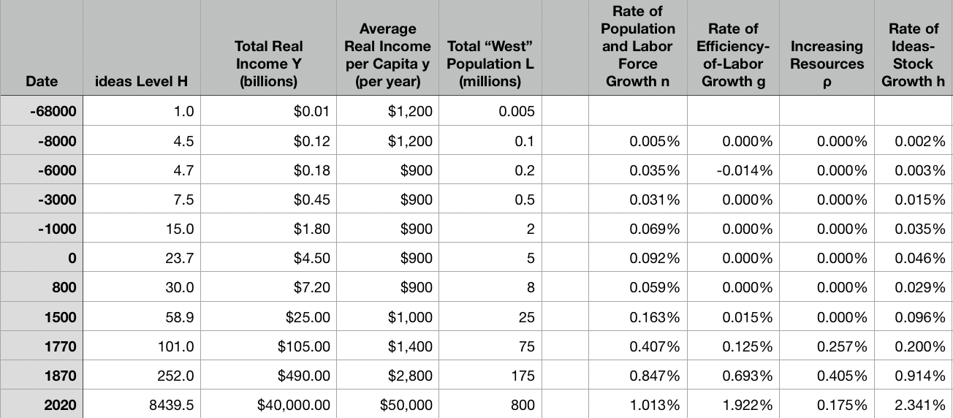
“The West”
800, 1500, 1770, or 1870?:

Slide 40
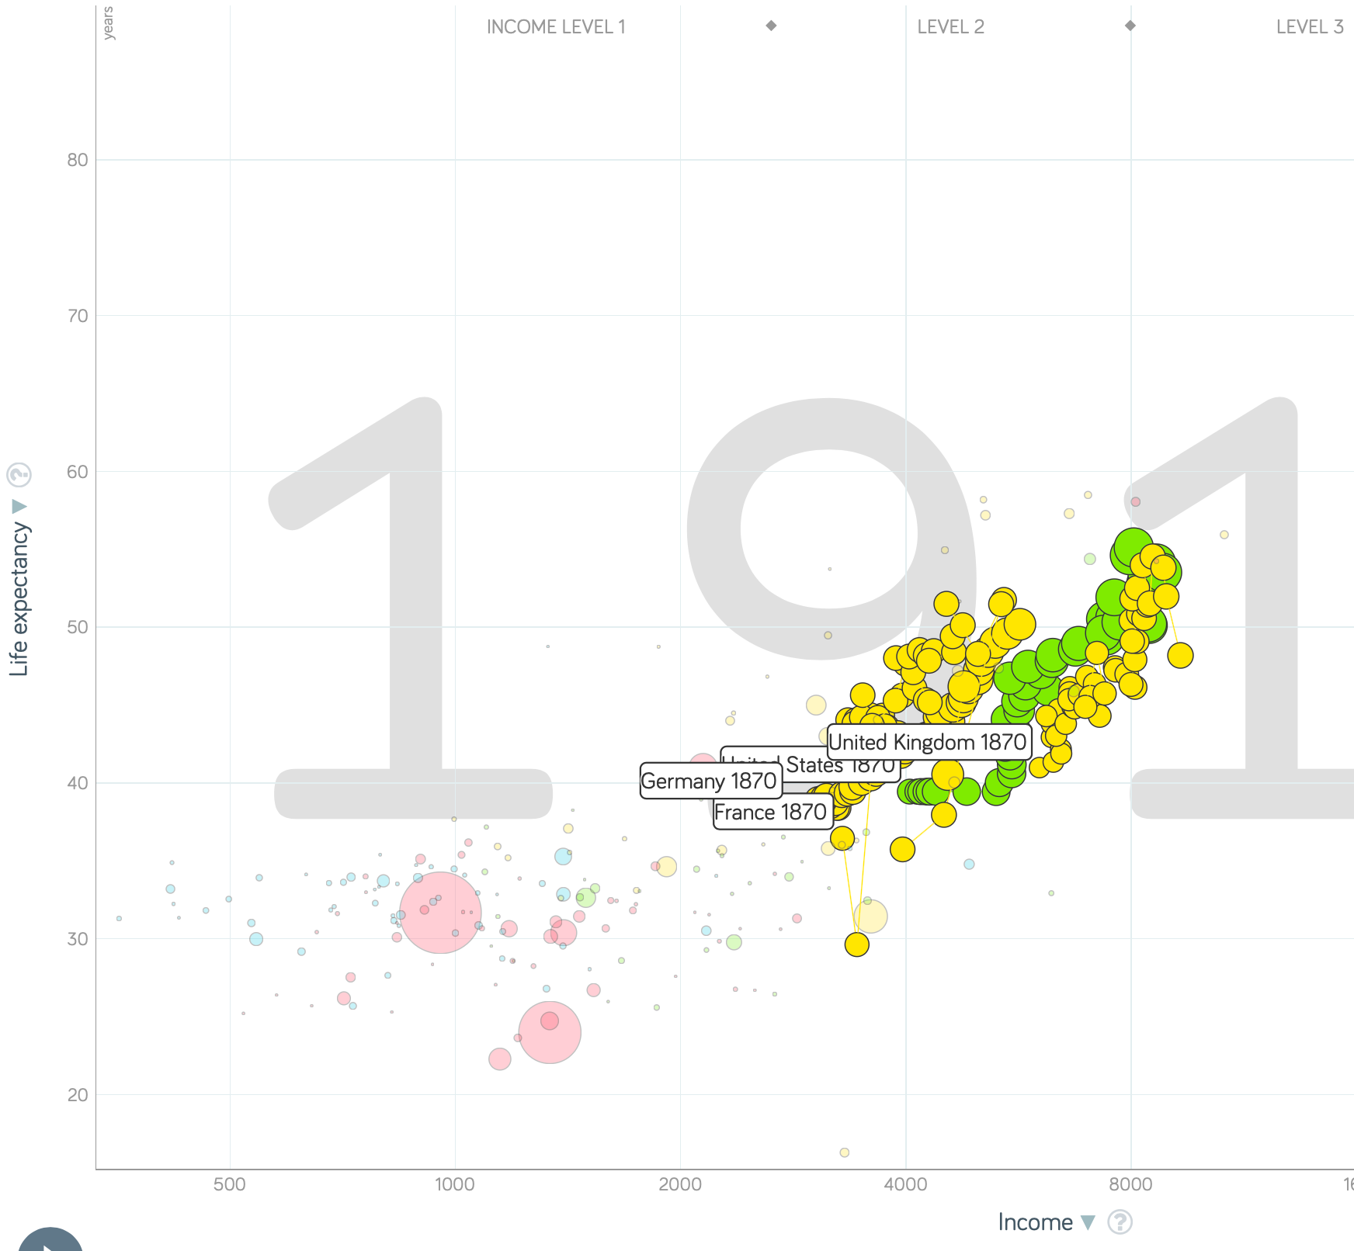
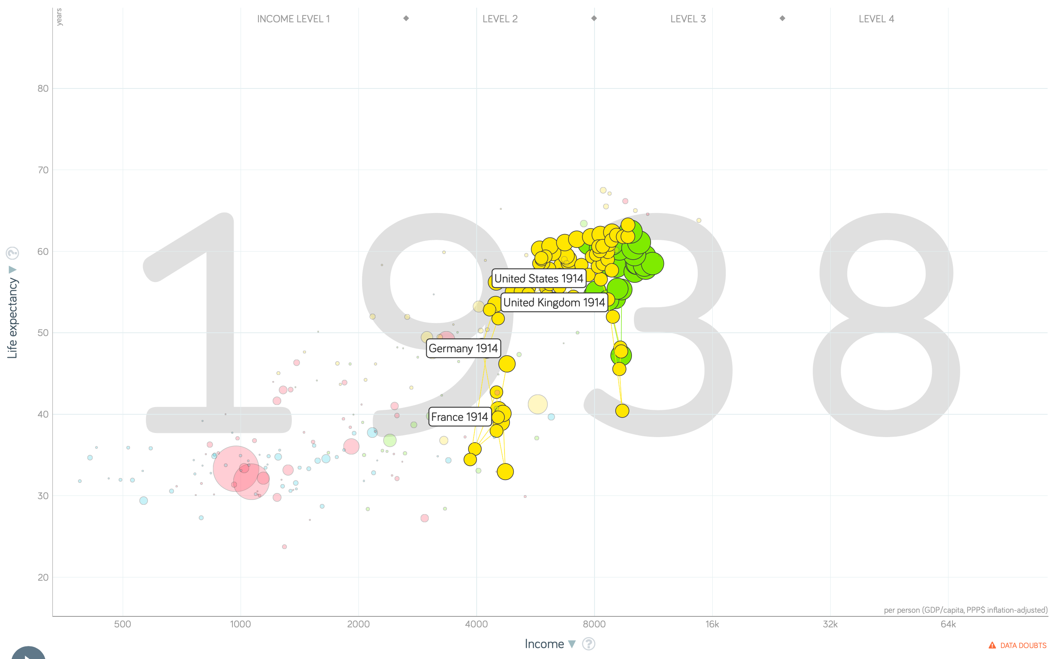
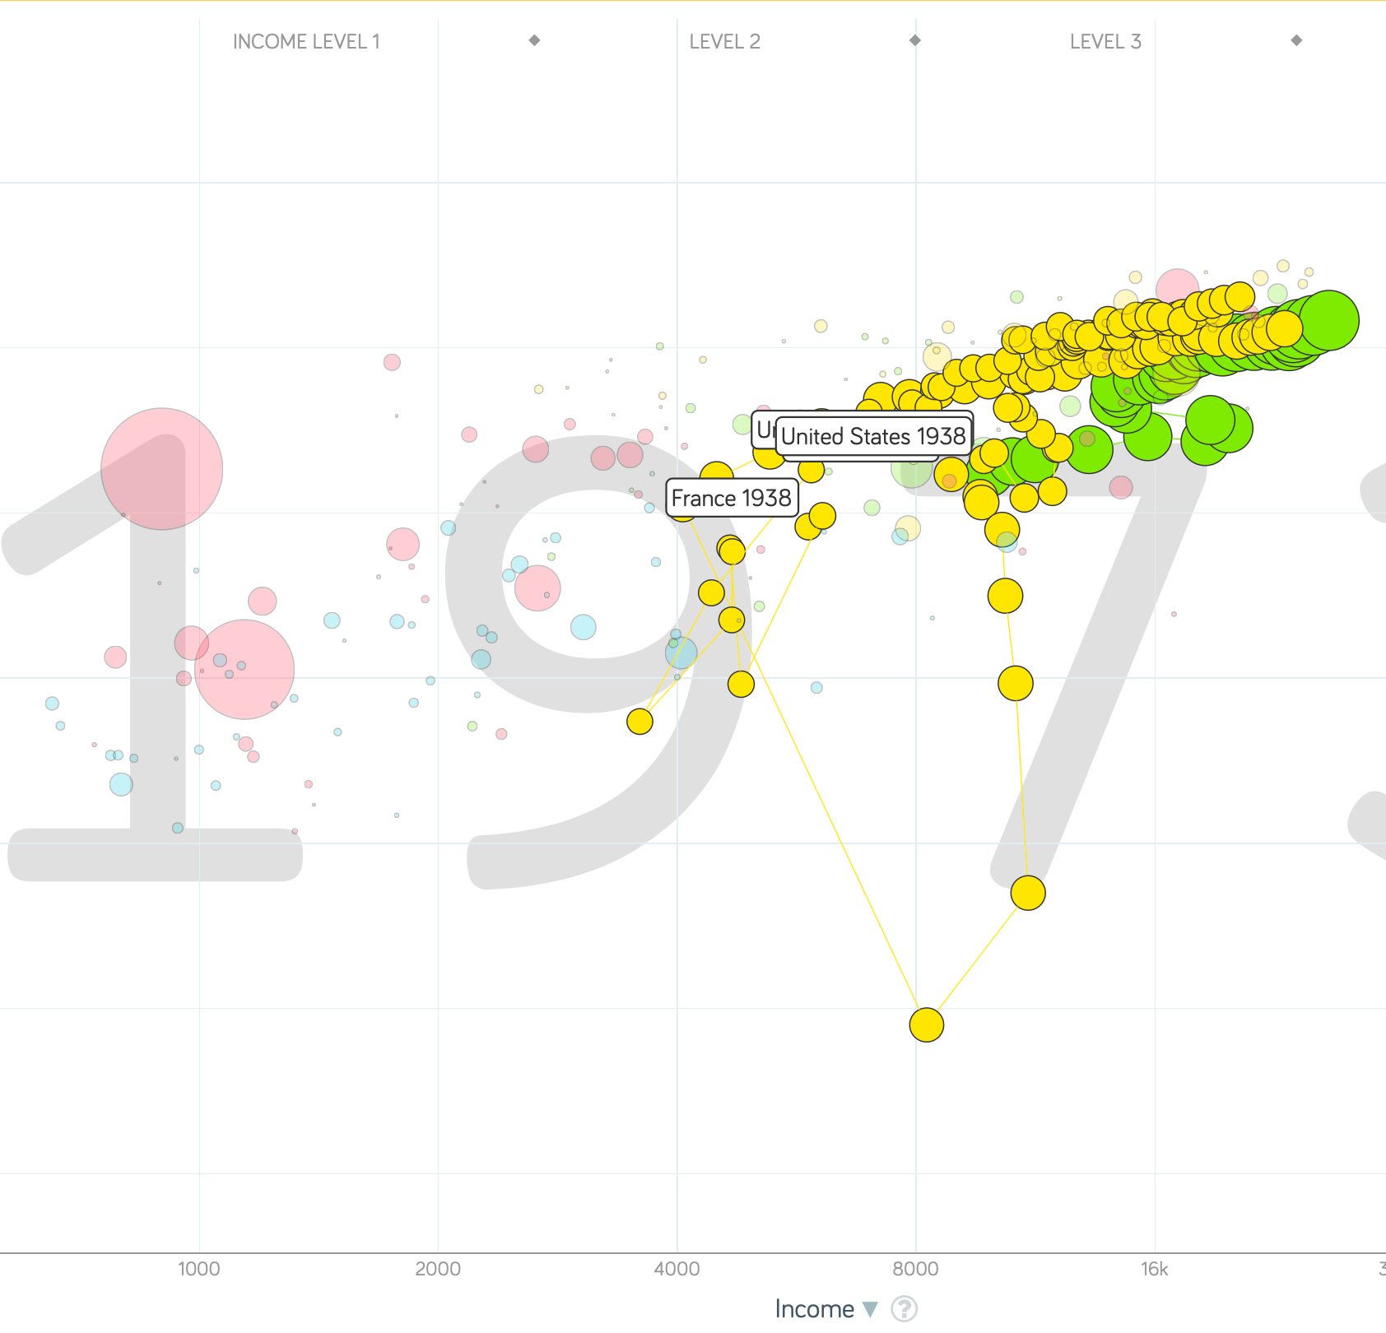
“The West”
1914-1938, 1870-1913, & 1938-1973
Rate of growth in the North Atlantic industrial core halves comparing 1870-1913 to 1914-1938; then triples afterwards over 1938-1973
Slows again after 1973

Slide 41
To Your iClickers
What was the growth rate of ideas in the industrial core of the world economy over 1870-2020?
About 2.3%/year
About 0.9%/year
About 0.23%/year
About 4%/year
None of the above

Slide 42
To Your iClickers
What was the growth rate of ideas in the industrial core of the world economy over 1770-1870?
About 2.3%/year
About 0.9%/year
About 0.23%/year
About 4%/year
None of the above

Slide 43
Review: The Belle Époque Broken
John Maynard Keynes:
“Very few of us realise[d] with conviction the intensely unusual, unstable, complicated, unreliable, temporary nature of the economic organisation by which Western Europe has lived for the last half century. We assume some of the most peculiar and temporary of our late advantages as natural, permanent, and to be depended on, and we lay our plans accordingly.
“On this sandy and false foundation we scheme for social improvement and dress our political platforms, pursue our animosities and particular ambitions, and feel ourselves with enough margin in hand to foster, not assuage, civil conflict in the European family....
“France, Germany, Italy, Austria, and Holland, Russia and Roumania and Poland, throb together, and their structure and civilisation are essentially one. They flourished together, they have rocked together in a war which we, in spite of our enormous contributions and sacrifices (like though in a less degree than America), economically stood outside, and they may fall together…”

Slide 44
Aristocracy & Social Democracy
The aristocrats had rolled the dice:
Europe in 1914 was a Europe of national populations, of industrialists and socialists, of factory workers and technicians…
Europe’s governments in 1914—especially the defense and foreign affairs ministries—had been populated by aristocrats, ex-aristocrats, and would-be aristocrats.
Landed, aristocratic, military elites had control of many of the levers of propaganda and power…
Aristocrats had had help. Industrialists and entrepreneurs were eager to provide their political support in return for economic benefits, as in the 1879 German “marriage of iron and rye”: the imposition of tariffs on imports of British steel (to protect the positions of German manufacturers) and on imports of American grain (to protect the positions of German landlords)…
On the eve of World War I, these landed military service aristocrats, ex-aristocrats, and would-be aristocrats increasingly found themselves members of a social caste that had no societal function…
But power—in the form of office and of vast (if declining relative) wealth—and propaganda—in the form of pageantry and the press—were reinforced by ideologies: Social darwinism…
The aristocrats rolled the dice—and lost…
Social democrats picked up the chips:
Expanded suffrage…
Proportional representation…
“Lands fit for heroes…”
How to provide for the benefits politicians promised?

Slide 45
Reparations, Taxes, and Inflation
Reparations
A peace “without annexations and indemnities”…
But not without reparations…
Two years’ of Germany’s national income demanded:
Much of it “boob bait for the bubbas…” on the part of Allied politicians…
But a powerful shaper of post-WWI Germany
Taxes
High and progressive tax rates…
A powerful impact on inequality…
Class war…
Inflation
U.S.: price level x1.5
Britain: price level x2.0
France: price level x7.0
French government had encouraged investment in Russian bonds…
German: price level x1,000,000,000,000
Austria, Hungary, Czechoslovakia the same…

Slide 46
Keynes’s Protest
Jan Christian Smuts:
“Poor Keynes often sits with me at night after a good dinner and we rail against the world and the coming flood. And I tell him that this is the time for Grigua’s prayer (the Lord to come himself and not to send his Son, as this is not a time for children). And then we laugh, and behind the laughter is [Herbert] Hoover’s horrible picture of thirty million people who must die unless there is some great intervention. But then again we think that things are never really as bad as that; and something will turn up, and the worst will never be. And somehow all these phases of feeling are true and right in some sense…”

Slide 47
Keynes’s Protest II
John Maynard Keynes:
“If we aim deliberately at the impoverishment of Central Europe, vengeance, I dare predict, will not limp. Nothing can then delay for long that final civil war between the forces of reaction and the despairing convulsions of revolution, before which the horrors of the late German war will fade into nothing, and which will destroy... the civilization and progress of our generation…”

Slide 48
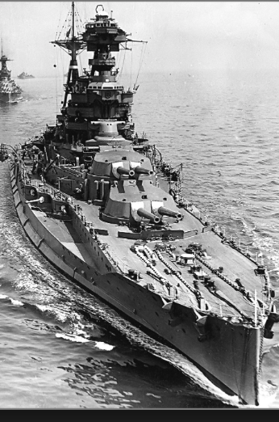
Review: World War I
Nationalism
Max Weber: “The vulgar conception of political economy is that it consists in working out recipes for making the world happy.… However… elbow-room… can [only] be won… through the hard struggle.... That standard of value adopted by a German economic theorist, can… be nothing other than a German policy and a German standard.... Our successors will... hold us responsible... for the amount of elbow-room we conquer.... The science of political economy is... a servant of... the lasting political-power interests of... our nation's power, and the vehicle of that power, the German national state…”
Erich von Manstein: von Manstein, von Lewinsky, Lewinski, Levi…
“We offered 4 battleships a year, the navy demanded 6, and we compromised at 8”

Slide 49
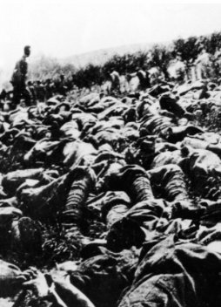
The Catastrophe of World War I: Origins
In the summer of 1914 the empires of Russia and Austria-Hungary are skirmishing diplomatically and threatening each other militarily about the latest Balkan crisis
Began when in the summer of 1914 the Archduke Franz Ferdinand and his wife Sophie were assassinated in Sarajevo
By terrorists with very close links to the intelligence service of the Kingdom of Serbia
What would Austria’s response be?
And then Germany attacks Belgium
And then Australia attacks Turkey

Slide 50
The Catastrophe of World War I: Causes
Why?: “If there is a war, let it come now…”
Russia thought it would have to fight Germany someday, and might as well while France was interested…
Austria, France, Britain (as a result of the German battle fleet) the same
“Busy giddy minds with foreign quarrels…”
A wiser man: Otto von Bismarck:
“There is nothing in the Balkans worth the bones of a single Pomeranian grenadier…”

Slide 51
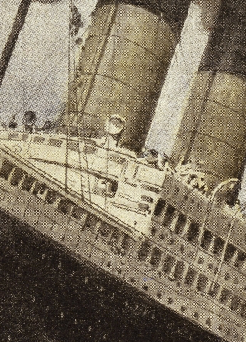
How Does the U.S. Get Involved?
British policy: binding the U.S. upper class to Britain since the 1840s
The Law of the Sea
Neutrals
Blockade
The submarine
Unrestricted submarine warfare
Zimmerman Telegram
Woodrow Wilson
“Teach the Mexicans to elect good men…”
“The war to end war…”

Slide 52
The Catastrophe of World War I: Outcome—Human
Combatants had mobilized 65M out of 100M men of military age
10M killed
10M maimed
Civilian casualties less than 10% of military
Costs of 1.5x a year’s GDP
Plus a 15M global flu epidemic
Russian, Austro-Hungarian, German, Ottoman Turkish Empires all gone…
Representative governments destabilized—or weak…
The Russian Revolution…
Hungarian, Bavarian socialist republics (short-lived)
Spartakist…
Allies demand 2 years of German GDP as “reparations”…

Slide 53
Catch Our Breath…
Comments?
Questions?

Slide 54

Review: Edward Bellamy: Looking Backward
Edward Bellamy: Looking Backward <https://delong.typepad.com/files/bellamy-backward.pdf>: Perhaps the third best-selling novel of the 19th century in the United States
2000 is a utopia…
The narrator is carried forward in time from 1887-2000 by an implausible plot device:
‘“This is the tenth day of September in the year 2000, and you have slept exactly one hundred and thirteen years, three months, and eleven days…”’
He then wanders around, looking at the utopia of 2000…
The opening:
‘“How could I live without service to the world?” you ask…. The answer is that my great-grandfather had accumulated a sum of money on which his descendants had ever since…. The sum had been originally by no means large. It was, in fact, much larger now that three generations had been supported upon it in idleness, than it was at first…’

Slide 55
The Stagecoach of Society
Those who ride and this who pull:
‘Commiseration was frequently expressed by those who rode for those who had to pull the coach, especially when the vehicle came to a bad place in the road, as it was constantly doing, or to a particularly steep hill. At such times, the desperate straining of the team, their agonized leaping and plunging under the pitiless lashing of hunger, the many who fainted at the rope and were trampled in the mire, made a very distressing spectacle, which often called forth highly creditable displays of feeling on the top of the coach.
‘At such times the passengers would call down encouragingly to the toilers of the rope, exhorting them to patience, and holding out hopes of possible compensation in another world for the hardness of their lot, while others contributed to buy salves and liniments for the crippled and injured. It was agreed that it was a great pity that the coach should be so hard to pull, and there was a sense of general relief when the specially bad piece of road was gotten over. This relief was not, indeed, wholly on account of the team, for there was always some danger at these bad places of a general overturn in which all would lose their seats.
‘It must in truth be admitted that the main effect of the spectacle of the misery of the toilers at the rope was to enhance the passengers’ sense of the value of their seats upon the coach, and to cause them to hold on to them more desperately than before…

Slide 56
The Stagecoach of Society II
“Finer clay”:
‘The other fact is yet more curious, consisting in a singular hallucination which those on the top of the coach generally shared, that they were not exactly like their brothers and sisters who pulled at the rope, but of finer clay, in some way belonging to a higher order of beings who might justly expect to be drawn. This seems unaccountable, but, as I once rode on this very coach and shared that very hallucination, I ought to be believed.
‘The strangest thing about the hallucination was that those who had but just climbed up from the ground, before they had outgrown the marks of the rope upon their hands, began to fall under its influence. As for those whose parents and grand-parents before them had been so fortunate as to keep their seats on the top, the conviction they cherished of the essential difference between their sort of humanity and the common article was absolute. The effect of such a delusion in moderating fellow feeling for the sufferings of the mass of men into a distant and philosophical compassion is obvious.
‘To it I refer as the only extenuation I can offer for the indifference which, at the period I write of, marked my own attitude toward the misery of my brothers…

Slide 57
The Stagecoach of Society III
Class war:
‘The sanguine argued very forcibly that it was in the very nature of things impossible that the new hopes of the workingmen could be satisfied, simply because the world had not the wherewithal to satisfy them. It was only because the masses worked very hard and lived on short commons that the race did not starve outright, and no considerable improvement in their condition was possible while the world, as a whole, remained so poor.
‘It was not the capitalists whom the laboring men were contending with, these maintained, but the iron-bound environment of humanity, and it was merely a question of the thickness of their skulls when they would discover the fact and make up their minds to endure what they could not cure.
The less sanguine admitted all this. Of course the workingmen’s aspirations were impossible of fulfillment for natural reasons, but there were grounds to fear that they would not discover this fact until they had made a sad mess of society. They had the votes and the power to do so if they pleased, and their leaders meant they should. Some of these desponding observers went so far as to predict an impending social cataclysm. Humanity, they argued, having climbed to the top round of the ladder of civilization, was about to take a header into chaos…’

Slide 58
The Limit of Human Felicity I
In the music room:
‘She made me sit down comfortably, and, crossing the room, so far as I could see, merely touched one or two screws, and at once the room was filled with the music of a grand organ anthem; filled, not flooded, for, by some means, the volume of melody had been per- fectly graduated to the size of the apartment. I listened, scarcely breathing, to the close. Such music, so perfectly rendered, I had never expected to hear.
‘“Grand!” I cried, as the last great wave of sound broke and ebbed away into silence. “Bach must be at the keys of that organ; but where is the organ?”…
‘“There are a number of music rooms in the city, perfectly adapted acoustically to the different sorts of music. These halls are connected by telephone with all the houses of the city…. Any one of the four pieces now going on that you prefer, you can hear by merely pressing the button which will connect your house-wire with the hall where it is being rendered…”’

Slide 59
The Limit of Human Felicity III
Four live orchestras you can listen to on the speakerphone!
‘“It appears to me, Miss Leete,” I said, “that if we could have devised an arrangement for providing everybody with music in their homes, perfect in quality, unlimited in quantity, suited to every mood, and beginning and ceasing at will, we should have considered the limit of human felicity already attained, and ceased to strive for further improvements…”’

Slide 60
Review: The View from 3000: Themes & Big Ideas
Science reaches critical mass and from it springs engineering—all of the engineering subdisciplines, including the management of human resources and of organizations. From a liberal political order spring national and then the global market economy. And from engineering and the market, and the large bureaucratic corporation then, over the course of 1870-2016, spring…
History was economic…
Explosion of wealth…
Cornucopia of technology…
Demographic transition…
Feminist revolution…
Inclusion and hierarchy attenuation…
Empowered tyrannies…
Wealth gulfs…
Mismanagement and insecurity…

Slide 61
Measuring Growth
What are my estimates of the rate of growth of economically-useful human knowledge over 1-1500, 1500-1800, 1800-1870, and 1870-2000?
0.02%/year, 0.2%/year, 0.5%/year, and 0.8%/year
0.000%/year, 0.02%/year, 0.2%/year, and 0.8%/year
0.02%/year, 0.2%/year, 0.8%/year, and 2.3%/year
0.2%/year, 0.8%/year, 2.3%/year, and 4.7%/year
None of the above.

Slide 62
What Is the Key Factor in the Explosion of Wealth in the 20th Century?
Yes, many things contributed. But suppose you have to pick just one

Slide 63
What Are the Four Factors That I See as Making for the Explosion of Wealth in the 20th Century?
Yes, there are many, many more things that contributed. But suppose you have to pick just four:

Slide 64
Demography II
What is the principal cause of the demographic transition?
Female wealth and control of property.
Female literacy.
Falling infant and child mortality.
Land shortages and high unemployment.
Something else.

Slide 65
Feminism
How many pregnancies do we think Abigail Smith Adams had between when she was 20 and 34?
2.
4.
6.
8.
18.

Slide 66
Empowered Tyrannies II
How many world leaders are members of the 10-million club?
2.
4.
6.
8.
18.

Slide 67
Inclusion and Hierarchy Attenuation
At the start of the 1970s, future President Ronald Reagan said that diplomats from Tanzania appeared uncomfortable:
resisting pressure to vote with the Soviet Union at the United Nations.
making small talk with New York socialites.
wearing shoes.
in formal tuxedos.
None of the above.

Slide 68
Economic Mismanagement and Insecurity II
According to Karl Polanyi, what rights does the market economy respect?
rights to land (a stable community).
rights to labor (a “just” income).
rights to finance (a stable economic place).
rights to property (the ability to keep what you manage to claim to earn).
None of the above.

Slide 69
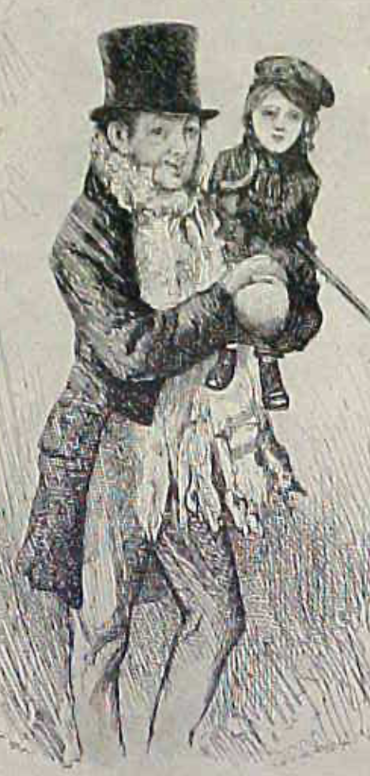
Review: The Watershed: 1870 as an Inflection Point
As of 1870, had the Industrial Revolution raised the standard of living or lightened the toil of the working class in England, the country at its center?
Yes
No
It’s not clear
Why? Malthusian forces—population explosion & thus smaller farm sizes. Growth, the growth had been slow 0.8%/year?

Slide 70
Globalization
Who called the era of globalization and growth from 1870 to 1914 an “economic El Dorado”?
Karl Marx
John Stuart Mill
Thomas Robert Malthus
John Maynard Keynes
None of the above
What would the others have said?

Slide 71
Migration
How many people of the roughly 1.5 billion then-population of the world left their continents of origin between 1870-1913?
10 million
50 million
100 million
200 million
400 million

Slide 72
Before 1870, Ideas Growth Not Fast Enough
And population growth accelerates as the world is not rich enough to undergo the demographic transition:
Value of useful and deployed ideas about technology and organization
-8000: 1
1: 3.5
1500: 4.75
1800: 9
1870: 16
2020: 421
Growth Rates:
-8000 to 1500: 0.02%/year
1500 to 1800: 0.2%/year
1800 to 1870: 0.8%/year
1870 to 2020: 2.3%/year
What caused these accelerations? What caused this last acceleration?

Slide 73
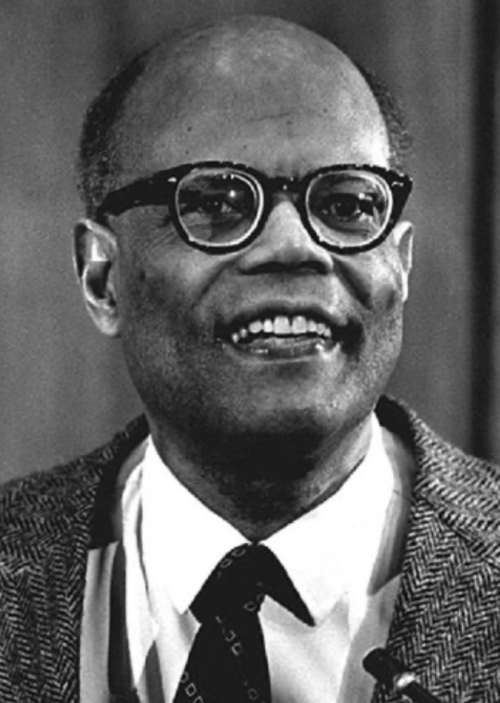
The Last Acceleration
The industrial research lab to routinize invention, and the modern corporation to routinize diffusion and deployment
Plus general purpose technologies—machine tools, non-human power sources
Arthur Lewis:
“New commodities: telephones, gramophones, typewriters, cameras, automobiles, and so on, a seemingly endless process whose latest twentieth-century additions include aeroplanes, radios, refrigerators, washing machines, television sets, and pleasure boats. Thus a rich man in 1870 did not possess anything that a rich man of 1770 had not possessed; he might have more or larger houses, more clothes, more pictures, more horses and carriages, or more furniture than say a school teacher possessed, but as likely as not his riches were displayed in the number of servants whom he employed rather than in his personal use of commodities…”
Not so much the particular technologies, as the grasping of the fact that there was a broad and deep range of new technologies to be discovered.
As much as it was new technologies, it was large-scale corporate organizations that could and did plan the division of labor to make use of and then market technologies.
And as much, it was that the global market meant that there was now a great deal of money to be made from the routinization of the exploration, development, and deployment of technological possibilities

Slide 74
Worldwide: The Broad Sweep
Post-1870 is the miracle:

Slide 75
“The West”
800, 1500, 1770, or 1870?:

Slide 76
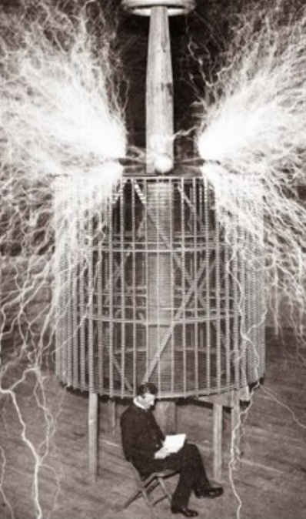
Who Is This Man?
And is he in any real danger?
Thomas Edison, and no
Andrew Carnegie, and no
Nicola Tesla, and no
Thomas Edison, and yes
Herbert Hoover, and yes

Slide 77
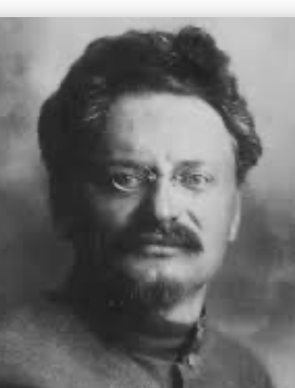
Lev Bronstein
Why did he say this?
“I had had no time to more than catch the general life-rhythm of the monster known as New York…”
“I left for Europe with the feeling of a man who has had only a peek into the furnace where the future is being forged…"

Slide 78

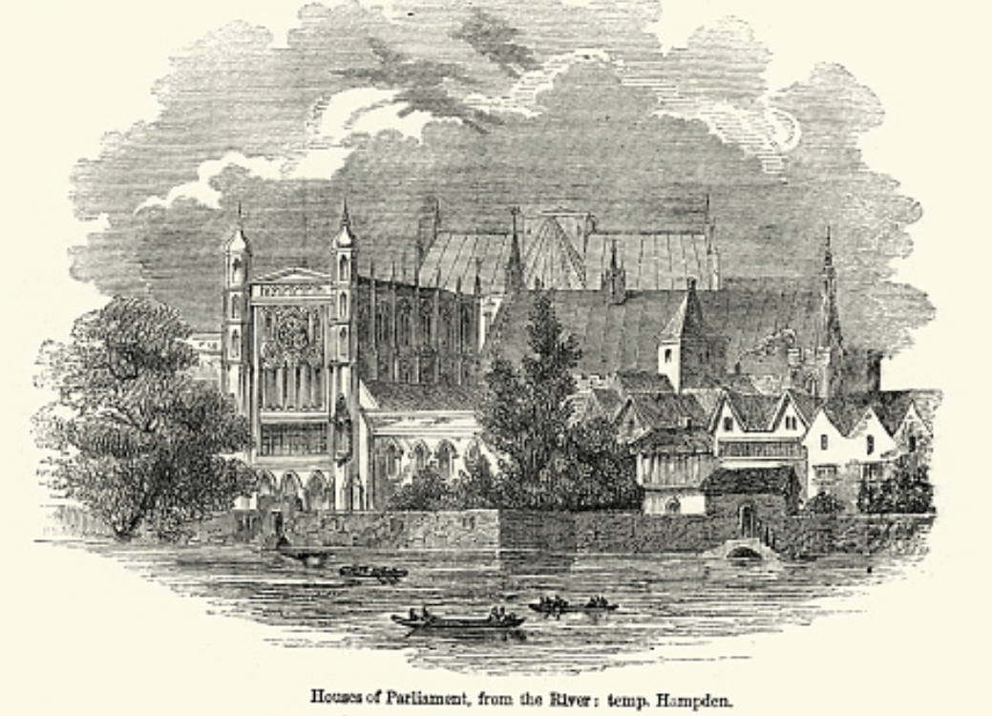
Review: Political Economy
From “Divine Right” and “Natural Order” to Enlightenment values…
Who was the first person to draft these words:?
“We hold these truths to be sacred & undeniable:
that all men are created equal & independant,
that from that equal creation they derive rights inherent & inalienable,
among which are the preservation of life, & liberty, & the pursuit of happiness;
that to secure these ends, governments are instituted among men, deriving their just powers from the consent of the governed…”
John Locke
Niccolo Machiavelli
Thomas Hobbes
Thomas Jefferson
George Washington
Why did he write them?

Slide 79
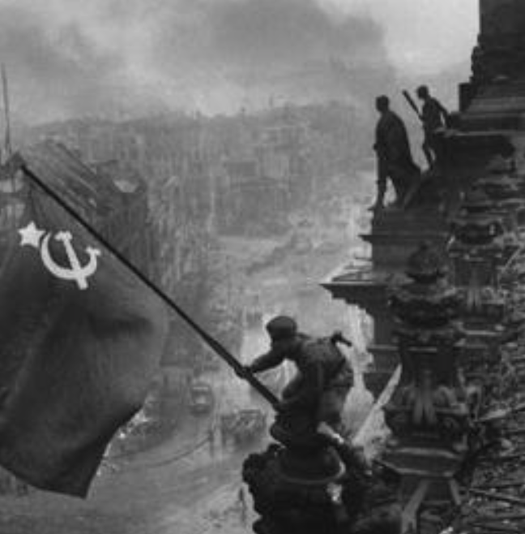
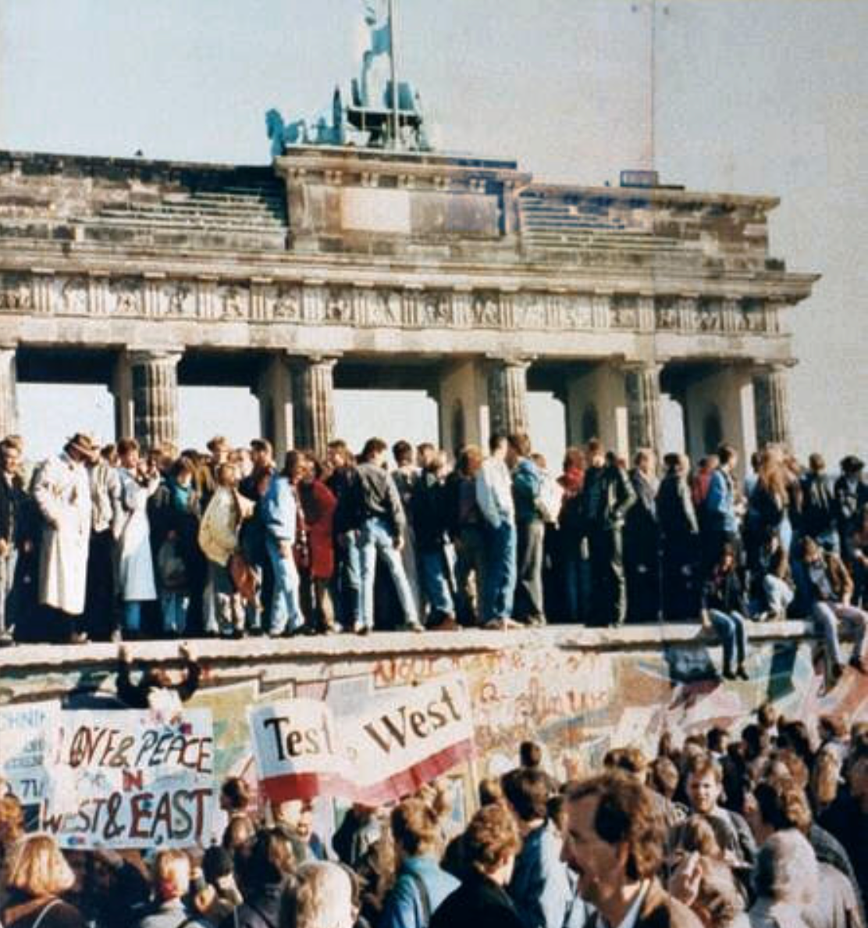
What Was the Proper Political Order?
Fears of “democracy” among American founders:
Madison: “Democracies have ever been spectacles of turbulence and contention... incompatible with personal security or the rights of property... as short in their lives as... violent in their deaths…”
Jefferson: “Gen’l Washington had not a firm confidence in the durability of our government… [& this] had some weight in his adoption of… ceremonies… calculated to prepare us gradually for a change which he believed possible…”
Hamilton: “the British government… best” as the only one “unit[ing] public strength with individual security…”
Adams: The American president should be announced as: “His Highness, the President of the United States, and Protector of the Rights of the Same…”
Question of political order thought settled: first in the rubble of Berlin in 1945, and then in the streets of East Germany in 1991:
Settled in favor of representative democracy, private property, & social insurance—late-1900s liberal democracy
But now reopened? Min Zhu (朱民) to me in 2015: “What are you Americans going to do to fix your broken political system?”

Slide 80
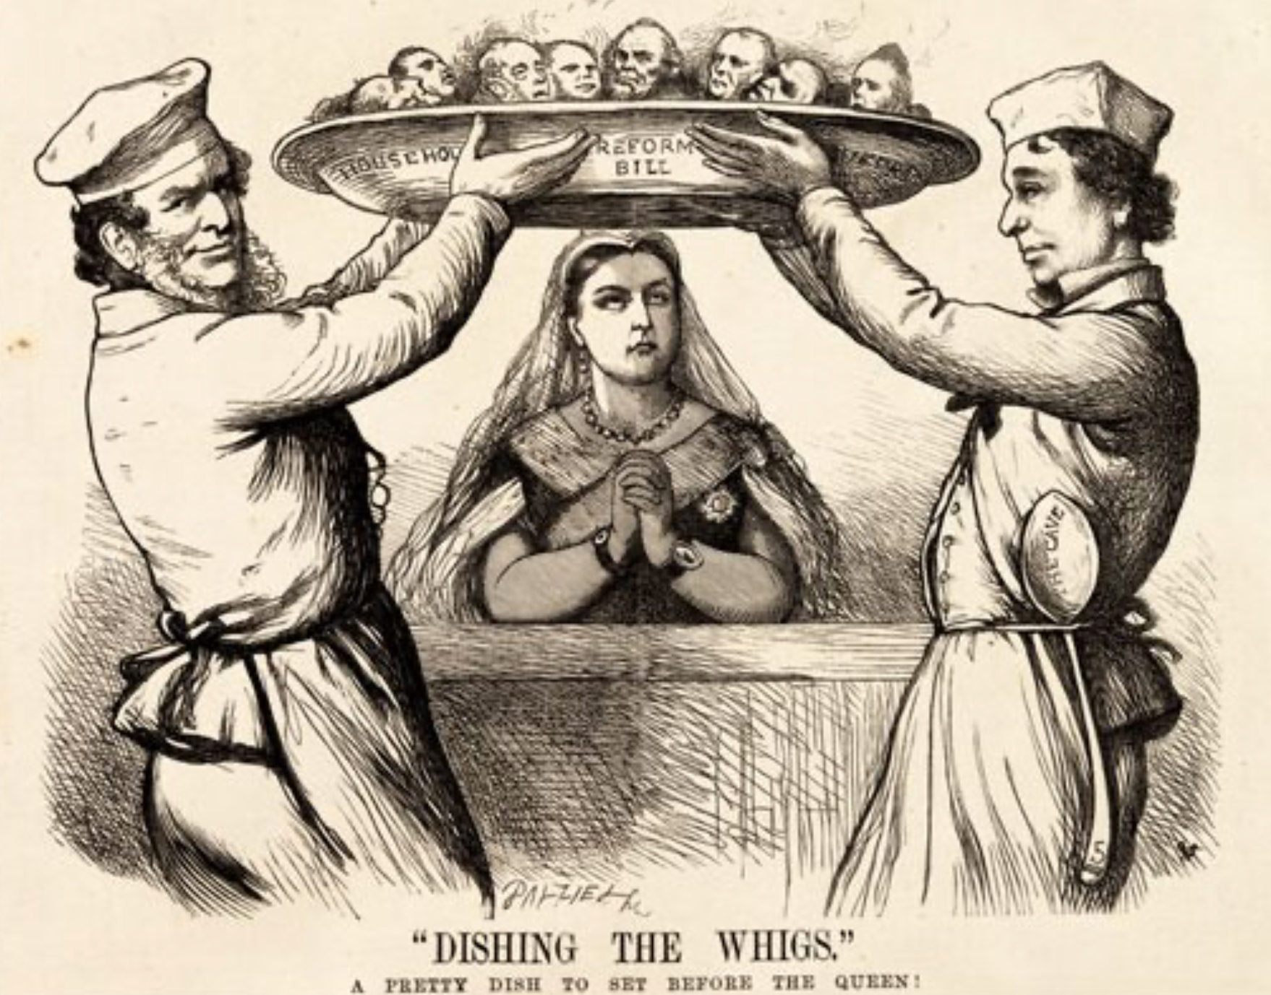
Franchise Restricted to the Rich Could Not Maintain Itself
The dynamic of franchise extension
Liberals in power would try extend on the principle that the new, poorer voters would be less conservative and would support them.
Threatening revolution would lead even conservatives to seek to extend the franchise in order to peel off of the revolutionary coalition those of the disenfranchised who had the most social power:
Earl Grey (yes, the tea): “The Principal… is to prevent… revolution…. I am reforming to preserve, not to overthrow…”
Charismatic leaders with popular followings would seek to give them votes, and then rule via plebiscites—going around the traditional elites
(Peculiar thing about Trump-Johnson: minority, and core is a minority of a minority…)
Conservatives: “dish the Whigs”—opportunities to form winning coalitions by appealing to those who were no profiting from the market economy, or felt that they were losing relative status in some ways…

Slide 81
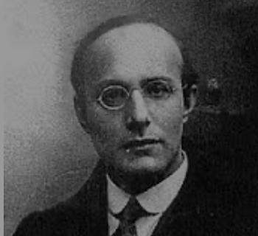
Popular Government and the Market Economy: Society’s Revenge
Karl Polanyi
People believe they have rights—to stable, supportive, nurturing communities; to incomes commensurate with their skills and status; and to money flows that will provide economic stability…
But a market society turns these things—land, labor, and finance—into commodities…
But they are not real commodities, they are fictitious commodities
And so you get your rights only if they satisfy a market profitability test
The only rights a market society respects are property rights:
& the only property rights that are worth anything are those that help you produce things for which rich people have a serious jones
Society will have its revenge: it will protect itself against the market logic, somehow, some way…

Slide 82
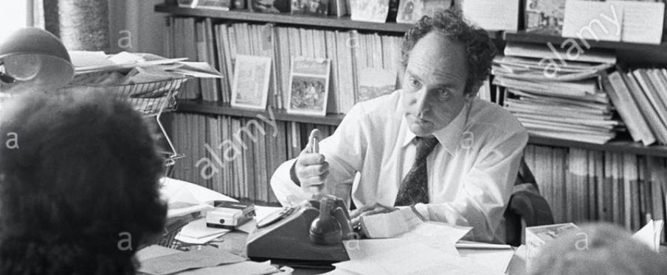


Digression: 5 Thinkers
Who shape my thought about the long 20th century—and how should, I think, shape yours
Beware! They are all deeply flawed…
But they are also geniuses, each in his way…
Beware of their followers! An iron law of ideology: a thinker’s most extravagant and aggressive followers will latch onto the stupidest and most shortsighted and wrong of their doctrines…
In historical order: Marx, Keynes, Hayek, Polanyi, Gellner
The other three thinkers:
Keynes: All that we need to produce general prosperity is technical adjustments to our system. Then the kingdom of freedom and prosperity will be within our grasp—and our major problems will no longer be economic ones
Gellner: The energy that most 19th century thinkers thought would go to “class“ went to “ethnos“ or “umma“ instead. The construction of ideological legitimations that makes sense both to dominants and to submissives who nevertheless believe they are part of some in-group is the key to understanding how societies stabilize themselves
Marx: Only the market economy will focus society’s energy on paying through the nose to boost the economy’s capital stock and to harvest the fruits of science and technology and then deploy them in production. But because the only demands in a market economy that matter are effective demands, the market economy also becomes a more “effective” means of slavery, for private property leads the proletariat to enslave themselves

Slide 83
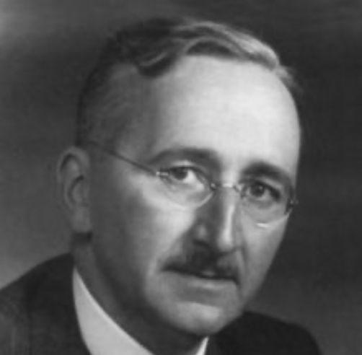
Hayek and Polanyi
Thumbnails on our first two:
Hayek:
Only the market economy can use society’s knowledge.
But the market economy cannot produce “social justice” and should not be asked to try—in fact, we need to recognize that all we can attain is freedom, and that will bring general prosperity, but that justice will be forever outside our reach
Polanyi:
The market economy turns land, labor, and finance into “fictitious commodities”
Society will have its revenge via a “double movement”

Slide 84
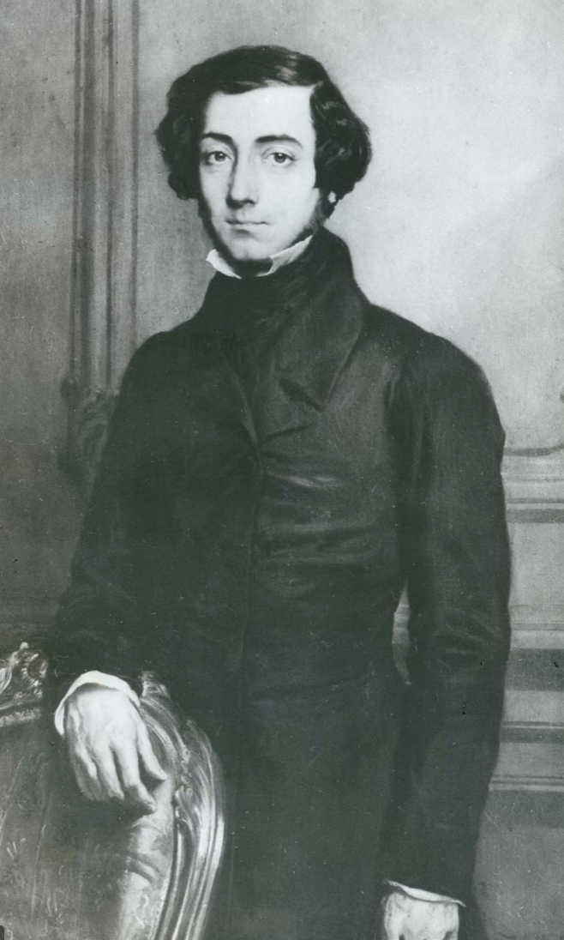
Plus Tocqueville
Toqueville on the rich as “elder brothers” in 1848:
“In the country all the landed proprietors, whatever their origin, antecedents, education or means, had come together, and seemed to form but one class: all former political hatred and rivalry of caste or fortune had disappeared from view. There was no more jealousy or pride displayed between the peasant and the squire, the nobleman and the commoner; instead, I found mutual confidence, reciprocal friendliness, and regard. Property had become, with all those who owned it, a sort of badge of fraternity. The wealthy were the elder, the less endowed the younger brothers; but all considered themselves members of one family, having the same interest in defending the common inheritance. As the French Revolution had infinitely increased the number of land-owners, the whole population seemed to belong to that vast family. I had never seen anything like it, nor had anyone in France within the memory of man…”
“The territorial aristocracy of past ages… [was] obliged… to come to the help of its servants and relieve their distress” no such reciprocal ties of obligation bound the aristocrats of manufactures to their workers: thus “the manufacturing aristocracy which we see rising before our eyes is one of the hardest that have appeared on the earth…”

Slide 85
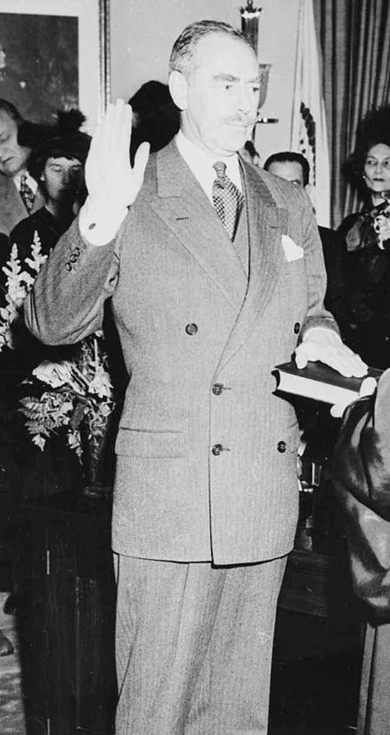
Plus Acheson
Dean Acheson, Secretary of State for Harry S Truman:
On the Republican Party as the party of wealth, enterprise, and opportunity:
“This business base of the Republican Party is stressed not in any spirit of criticism. The importance of business is an outstanding fact of American life. The achievements of business have been phenomenal. It is altogether appropriate that one of the major parties should represent its interests and its point of view…”
The subsequent transformation of the Republican Party from those who were going to become millionaires, or become even greater millionaires; to those who fear that they would lose it all…

Slide 86
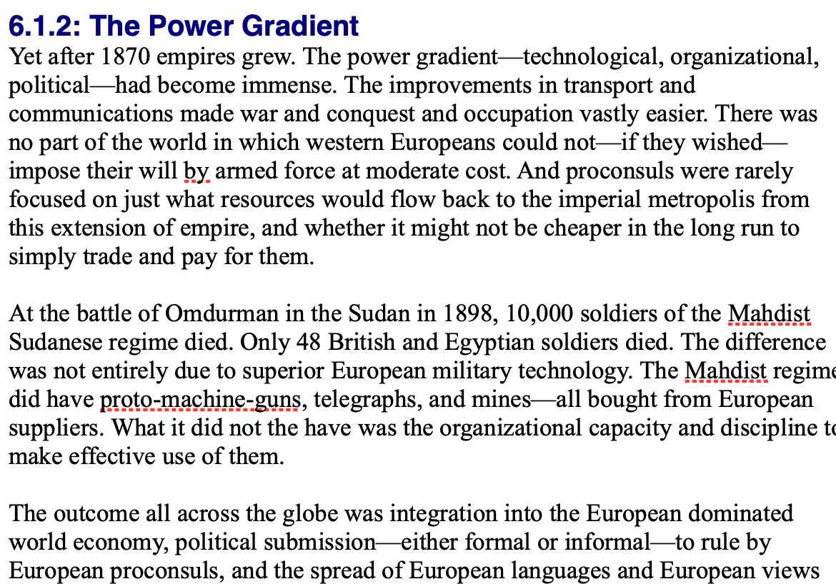
Review: Empire
By 1810 the tide of empire had been clearly ebbing…
But then things turned around: the power gradient:

Slide 87
To Your iClickers!
According to Eichengreen, graphing international capital flows and mobility since 1850 over time produces a graph that is:
V-shaped
U-shaped
W-shaped
An upward line
None of the above

Slide 88
To Your iClickers!
According to Eichengreen, the responsibilities of a pre-World War I central bank as steward of the global gold standard and also as lender-of-last-resort in domestic financial crises were:
in complete harmony
in irresolvable tension
for the most part manageable, before World War I at least, via fancy footwork and good luck
not understood
none of the above

Slide 89
To Your iClickers!
According to Eichengreen, the experience of being on the gold standard for North Atlantic economies in the 1870-1914 period was by and large a happy one, and the experience of countries at the world economy’s periphery was:
also by and large a happy one.
a mixed one.
a source of considerable tension, instability, and political upset.
once again, manageable with fancy footwork and a little good luck.
none of the above.

Slide 90
To Your iClickers!
In Eichengreen’s view, if World War I had somehow been avoided, would the global gold standard have remained stable in the 1920s and 1930s?
There are no guarantees, but probably yes.
There are no guarantees, but probably no.
Certainly not!
Certainly yes—unless several North Atlantic economies experienced a socialist revolution
None of the above.

Slide 91
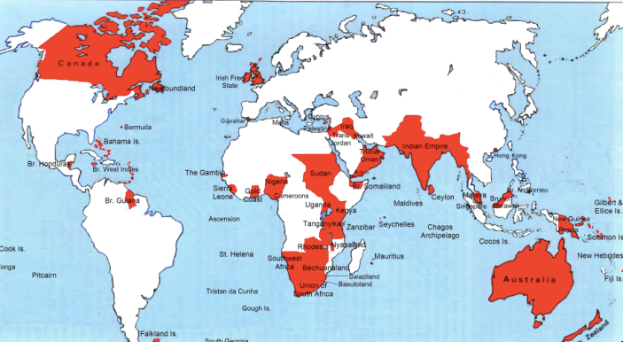
Empire

Slide 92
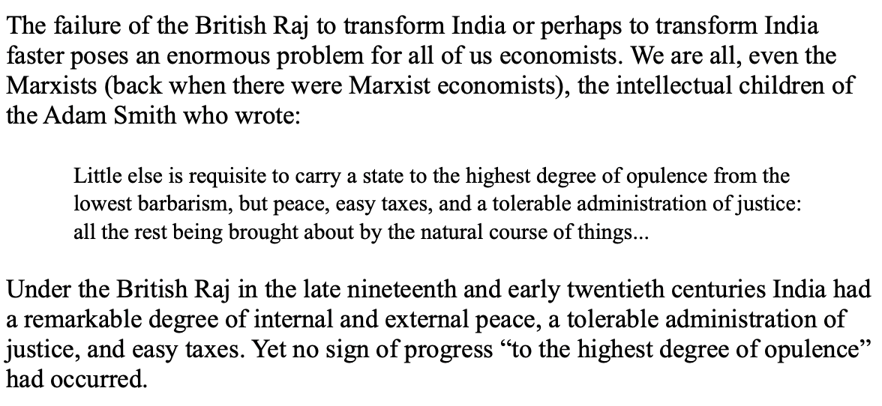
India
Why didn’t the British transform India into an industrial power?

Slide 93
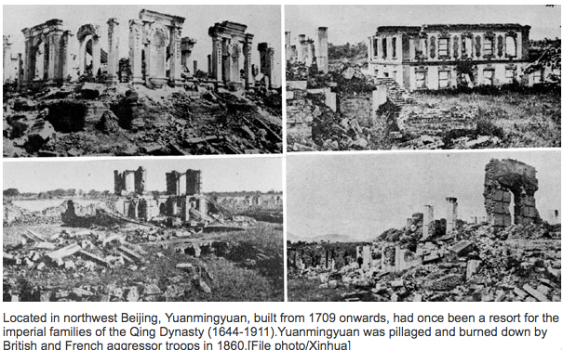
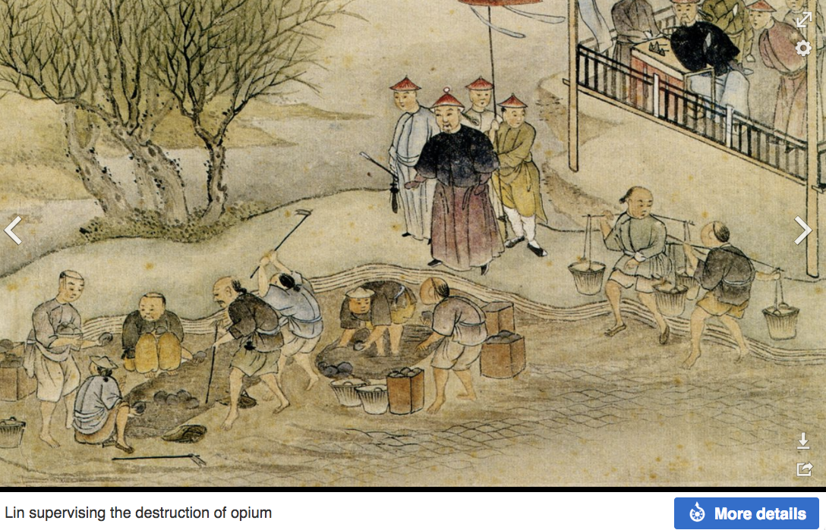
“Self-Strengthening”
The puzzle of China vs. Japan
Great Qing (大清)(1644-1912)
Wu Sangui (吳三桂)
The Rebellion of the Three Feudatories (三藩之亂)
Kangxi and Qianlong: “revere the emperor and expel the barbarians” is difficult to pursue when the emperor and his clan identify themselves as “barbarians”
Tai-Ping Rebellion (太平天國運動)
Cixi ( 慈禧太后)
Li Hongzhang (李鴻章)the Kai-Ping coal mine, Chang Yen-Mao, and Herbert Hoover

Slide 94
Formal Empires
There were, broadly, three views as to why European late-1800s empires rose to such domination, each of which with its own view of what was to be done to fix the situation:
One view is that of John Hobson: The major economic problem was the business cycle. Equipping the military needed to maintain the empire puts people to work. And an empire is a good source of consumers for the products of domestic factories. European governments that pursued empire, Hobson thought, were less likely to face economic distress and so more likely to continue in office.
A second view was that of Joseph Schumpeter: imperialism as the last gasp of military status aristocracy.
The third view was that empires were ordained by God—or at least morally required or desirable, for European powers had a civilizing mission. The Europeans were lucky enough to be the grownups, and it was the obligation of the grownups to civilize the world. But perhaps civilization is best spread by newspapers and books and merchants and engineers, rather than by alien proconsuls? Just a thought.

Slide 95
Informal Empires
But even where Britain (or France, or Germany, or Portugal, or Spain, or those who thought of themselves as descended from the conquistadores of Castile, or Anglo-Saxon settlers) did not rule, they reigned:
Britain seemed successful: playing by Britain’s rules seemed wise…
Britain was powerful: playing by Britain’s rules seemed likely to keep it from getting annoyed…
Britain was working very hard to make itself attractive—to make becoming a Briton-by-proxy of some sort straightforward and profitable in both money and cultural terms…
Britain was the first-mover hegemon: international cooperation was on its terms…

Slide 96
Catch Our Breath…
Comments?
Questions?

Slide 97
Review: Revolutions
“Petty Officer Lemmgen… arrived at the Ministry [of War]… found… Lieutenant HambuRger.... Lemmgen produced a typed document with the following text: ‘Comrades and Workers! The Ebert-Scheidemann government have made themselves impossible.... The undersigned Revolutionary Council has provisionally assumed power.’
“Lieutenant Hamburger inspected the document and became properly indignant. ‘But where are the signatures? Before I can comply with this order, you’ll have to go back and get it properly signed. Otherwise any little shorthand typist could declare the government deposed.’ Petty Officer Lemmgen... saw the logic…. So he and his men saluted... and made their way back to the Revolutionary Council to obtain the necessary signatures....
“But by the time he had obtained the signatures, Lemmgen had learned that the People’s Naval Division had declared itself neutral. So he did not return to the Ministry of War…”

Slide 98
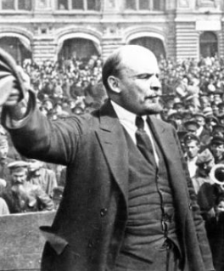
Lenin
A quick power grab…
Confidently expecting a German revolution, and then massive aid…
Brutal civil war
Kerenskyites
Reds
Whites
Nationalists
What was the revolutionary government to do?
Ludendorff’s German war economy…

Slide 99
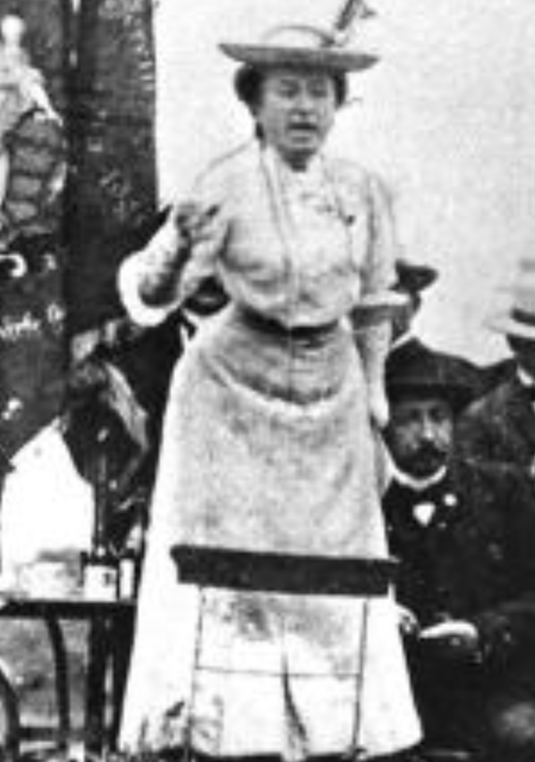
Red Rosa on Lenin
“Without general elections, without unrestricted freedom of press and assembly, without a free struggle of opinion, life dies out in every public institution…. Only the bureaucracy remains…. A few dozen party leaders of inexhaustible energy and boundless experience direct and rule….
“An elite of the working class is invited from time to time to meetings where they are to applaud the speeches of the leaders, and to approve proposed resolutions unanimously–at bottom, then, a clique affair…. Such conditions must inevitably cause a brutalization of public life: attempted assassinations, shooting of hostages, etc…
“Freedom only for the supporters of the government, only for the members of one party–however numerous they may be–is no freedom at all. Freedom is always and exclusively freedom for the one who thinks differently. Not because of any fanatical concept of “justice” but because all that is instructive, wholesome and purifying in political freedom depends on this essential characteristic, and its effectiveness vanishes when ‘freedom’ becomes a special privilege…

Slide 100

Review: The U.S.: The Roaring Twenties
The boom of the 1920s
Mass production—the flowering of the Second Industrial Revolution
“The business of America is business”
Structural changes in the 1920s…

Slide 101
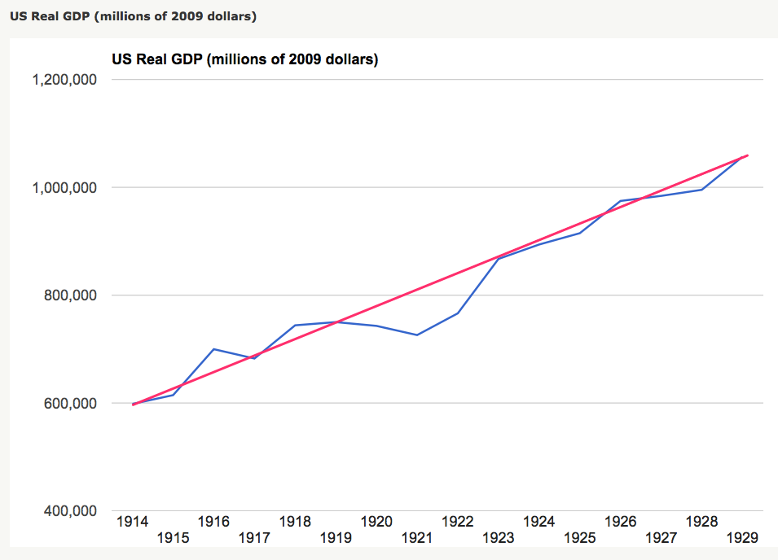
Structural Changes in the 1920s
Mass production—Henry Ford and the Model T
End of mass immigration—immigration restrictions of 1924
What do these do to the demand for construction, and construction workers?
The role of the stock market…
The role of the banking system…

Slide 102
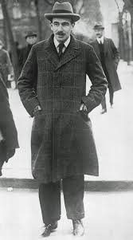
Review: To Your iClickers
John Maynard Keynes thought that the prosperity of the pre-WWI years was:
Natural and stable: a logical development out of human drives that went from strength to strength, and could only be overthrown by a very unlikely disaster.
Artificial and unstable, and based on a very complicated system in which, largely by chance, a lot happened to go right.
Natural but unstable, in that it was a logical development out of humanity’s trading nature but could be disturbed by other human drives—like tribalism, and the lust for domination.
Artificial but stable, as constructed by the greatest minds of the age, and only overthrown by a very unlikely disaster.
None of the above

Slide 103
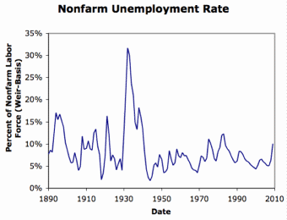
Review: Why the “Perfect Storm” of 1929-1933?
Previous Cycles:
1873—railroad
1884—railroad redux
1893—free silver
1904—Northern Securities
1907—gold drain to Britain
1914—disruption of the start of WWI
1920—deflation; return to “normalcy”
What brought previous downturns to a halt?
What made the Great Depression so great?

Slide 104
General Glut
How is it that there can be a "general glut" in which pretty much every produced commodity and the labor of workers are in excess supply, given that humans are far from satiated with production goods and given that one person's expenditure is another person's income?
Remember: you can take your income and use it either to buy things that are useful or to build up your stock of cash money. If there is excess demand for useful commodities, people can switch from producing whatever they were making to producing whatever is in short supply.
But the only way to build up your stock of cash is to try to cut your spending below your income. And since one person's spending is another person's income, that simply cannot be done in general.
If people in general try, the result is that spending and incomes fall economywide until they are both at such a low level that people de-prioritize building up their cash holdings.

Slide 105
What Had Ended Previous Downturns?
Previous Cycles:
1873—RR investment drops to zero
1884—RR investment drops to zero
1893—confidence that gold standard will be kept
1904—Theodore Roosevelt
1907—J.P. Morgan constitutes himself a pick-up central bank
1914—profits from European war demand WWI
1920—Federal Reserve reverses course

Slide 106
Interwar Gold Standard
The interwar gold standard caused, deepened, and definitely did nothing toward curing or ameliorating the Great Depression?
There is nothing worse than attempting to credibly commit to an incredible policy
The fear that the gold standard would break down caused people to want to hoard cash—to build up their cash holdings.
The fear that the gold standard would break down caused governments to be extremely unwilling to boost their economies' cash supplies—such boosts might, governments feared, undermine confidence that their country would stay on the gold standard.
Big depressions happen when the popular demand for cash outstrips the government's supply
The interwar gold standard was thus a powerful motivator and stage-setter pushing both people and governments into the patterns of behavior that produced the Great Depression

Slide 107
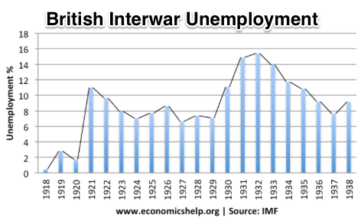
“Crying ‘Fire! Fire!’ in Noah’s Flood…”
France gold acquisition policy
American gold acquisition policy
The weakness of the gold-exchange standard—that people knew the gold standard could and would be abandoned
Labor-side pressure…
Nothing worse than an attempt to credibly commit to an incredible policy…
And then the belief that inflation was always just around the corner…

Slide 108
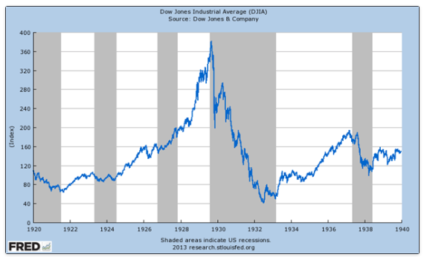
The Role of the Stock Market
Stock market doubles between the start of 1927 and late 1929
Positive-feedback margin trading
And a large number of people coming into the market who do not understand what is going on
Castles in the air
Prohibition?
Monetary policy?
Mass production?
The expectations shock produced

Slide 109
Why Was the Great Depression so Great?
John Maynard Keynes:
“When once the recovery has been started, the manner in which it feeds on itself and cumulates is obvious. But during the downward phase, when both fixed capital and stocks of materials are for the time being redundant and working-capital is being reduced, the schedule of the marginal efficiency of capital may fall so low that it can scarcely be corrected, so as to secure a satisfactory rate of new investment, by any practicable reduction in the rate of interest.
“Thus with markets organised and influenced as they are at present, the market estimation of the marginal efficiency of capital may suffer such enormously wide fluctuations that it cannot be sufficiently offset by corresponding fluctuations in the rate of interest. Moreover, the corresponding movements in the stock-market may, as we have seen above, depress the propensity to consume just when it is most needed. In conditions of laissez-faire the avoidance of wide fluctuations in employment may, therefore, prove impossible without a far-reaching change in the psychology of investment markets such as there is no reason to expect.
“I conclude that the duty of ordering the current volume of investment cannot safely be left in private hands….”

Slide 110
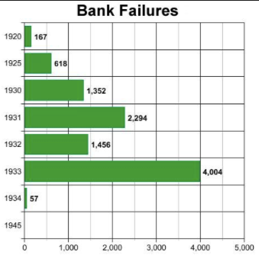
The Role of the Banking System
In the United States in the 1920s, about 600 banks failed a year—largely small rural banks
But banks set out to make riskier and riskier loans
Do they count on rescue from the Federal Reserve?
And when the Great Depression hits, bank failures rise to previously-unimaginable heights
Is there anything that could do more to boost the demand for or reduce the supply of cash?
And so call forth a general glut?
Lenders of “last resort”?

Slide 111
The Presumption Before the Great Depression
The presumption before the Great Depression that the government was not responsible for managing and curing the business cycle…
Two strands reinforced each other.
The first was the strength of the idea of laissez-faire: that government (protecting property and enforcing contracts aside) was overwhelmingly a problem and not a solution. As John Maynard Keynes wrote in his essay The End of Laissez-Faire, a powerful drive behind that was: “the corruption and incompetence of eighteenth-century government…. Almost everything which the State did in the eighteenth century in excess of its minimum functions was, or seemed, injurious or unsuccessful. [And] on the other hand, material progress between 1750 and 1850 came from individual initiative…”
The second was social Darwinism—that, in the words of steelmaster Andrew Carnegie, the second-richest man in America circa 1905 and a man who gave away his entire fortune: “The price we pay for [our civilization]... is, no doubt, great.... The employer of thousands is forced into the strictest economies... [in] the rates paid to labor.... The law of competition... is here; we cannot evade it; no substitutes for it have been found; and while the law may be sometimes hard for the individual, it is best for the race, because it insures the survival of the fittest in every department..."
The result was a dominant belief—at least among the rich and powerful—that:
The market giveth, the market taketh away: blessed be the name of the market.

Slide 112
The Hoover Administration’s Reaction to the Great Depression
The 1929-1933 Hoover administration believed that little could be done.
That the only good things that could be done were to (a) repeatedly state that "prosperity is just around the corner" and (b) try to cut federal government spending and raise taxes in order to restore confidence and scotch the fear of high inflation.
As economist R.G. Hawtrey wrote, to worry about inflation in the midst of the Great Depression was like "crying 'FIRE! FIRE!' in Noah's Flood..."
Herbert Hoover himself wrote afterwards about how his administration had been dominated by the "'leave-it-alone liquidationists' headed by Secretary of the Treasury Mellon, [who] felt that government must keep its hands off and let the slump liquidate itself. Mr. Mellon had only one formula:
'Liquidate labor, liquidate stocks, liquidate the farmers, liquidate real estate'. He held that even panic was not altogether a bad thing. He said: 'It will purge the rottenness out of the system. High costs of living and high living will come down. People will work harder, live a more moral life. Values will be adjusted, and enterprising people will pick up the wrecks from less competent people'…"
Hoover went on to state that he did not share this view…
That raises lots of questions about how his administration worked…

Slide 113
To Your iClickers
The largest automobile manufacturer in the world in 1928 was:
Toyota
Daimler-Benz
Peugeot
Ford
General Motors

Slide 114
To Your iClickers…
Worldwide, the Great Depression was was:
In relative terms, equalled by the Cleveland Depression of 1893-6
In relative terms, smaller than the depression that followed the Crash of 1873
In relative terms, equalled by the Great Recession of 2008-2020
In relative terms, by far the largest depression ever
None of the above

Slide 115
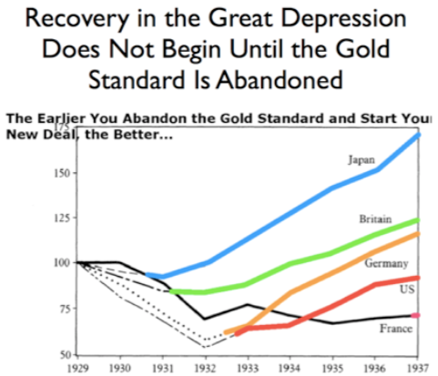
Review: New Deals
Japan: Takahashi Korekiyo
moved early to maintain full employment
Britain: MacDonald-Snowden-Baldwin
Forced off…
Germany: Adolf Hitler
Succeeds Bruening
America: Franklin Delano Roosevelt
Succeeds Herbert Hoover
France: Leon Blum

Slide 116
Recovery
Japan recovered the fastest,
Germany second,
Britain third,
The U.S. fourth,
France last.
By-and-large, the sooner you abandon the gold standard, expand the money supply, and undertake a "New Deal" to boost government spending, the better…

Slide 117
The Polanyian Perplex
People believe that the rights they have are broader and deeper than simply property rights, but the market economy disagrees.
Thus either governments will find a way to guarantee their populations these extra rights to community stability, general prosperity, and full employment, or society will react somehow against the liberal market-oriented political-economic system.
“Fictitious commodities”:
Land
Labor
Finance
Society’s “double movement”

Slide 118
The Permanent Problem of the Human Race
John Maynard Keynes thought that the economic problem would not be the "major problem of the human race"
By the end of the twentieth century the human race would be so rich that people would be practically satiated with commodities.
Thus the "economic problem" of how to economize and be efficient, and allocate scarce means among alternative uses, was not the permanent problem of the human race.
Instead, "for the first time since his creation man will be faced with his real, his permanent problem-how to use his freedom from pressing economic cares, how to occupy the leisure, which science and compound interest will have won for him, to live wisely and agreeably and well.... It will be those peoples, who can keep alive, and cultivate into a fuller perfection, the art of life itself and do not sell themselves for the means of life, who will be able to enjoy the abundance when it comes..."
Yet Keynes was not sure that having to confront this problem would be a net plus for humanity: "Will this be a benefit? If one believes at all in the real values of life, the prospect at least opens up the possibility of benefit. Yet I think with dread of the readjustment of the habits and instincts of the ordinary man, bred into him for countless generations, which he may be asked to discard within a few decades..."

Slide 119
Digression: How to Study
Will I ask you about Jan Christian Smuts? About the prayer (and theology) of the Grigua?
No…
Themes and concepts…
But you need narratives and stories to hang onto them…
And our brains are very good at deep-sixing useless information
Andy Matuschak: Why Books Don’t Work <https://andymatuschak.org/books/>:
“Picture some serious non-fiction tomes. The Selfish Gene; Thinking, Fast and Slow; Guns, Germs, and Steel; etc.
“Have you ever had a book like this—one you’d read—come up in conversation, only to discover that you’d absorbed what amounts to a few sentences? I’ll be honest: it happens to me regularly. Often things go well at first. I’ll feel I can sketch the basic claims, paint the surface; but when someone asks a basic probing question, the edifice instantly collapses. Sometimes it’s a memory issue: I simply can’t recall the relevant details. But just as often, as I grasp about, I’ll realize I had never really understood the idea in question, though I’d certainly thought I understood when I read the book. Indeed, I’ll realize that I had barely noticed how little I’d absorbed until that very moment. I know I’m not alone here…

Slide 120
Skipped Topic: Pre-1914 Political Economy: Over in Europe
The June Days of 1848 in Paris:
Tocqueville:
“The insurrection of June [1848]... class against class... a blind and rude, but powerful, effort on the part of the workmen to escape from the necessities of their condition, which had been depicted to them as one of unlawful oppression…. The closing of the national workshops… occasioned the rising…”
“Thousands… hastening to our aid from every part of France.... Thanks to the railroads, some had already come from fifty leagues’ distance... every class of society... peasants... shopkeepers... landlords and nobles all mingled together... they rushed into Paris with unequalled ardour: a spectacle as strange and unprecedented in our revolutionary annals.... The insurgents received no reinforcements, whereas we had all France for reserves…”

Slide 121
French Politics
Régimes stability is not on the menu:
the terrorist dictatorship of the Jacobins (the mainspring of popular government… amid revolution it is at once virtue and terror: virtue, without which terror is fatal; terror, without which virtue is impotent…)
a corrupt and gerrymandered 5-man executive of the Directory, defended on October 5, 1795 by the “whiff of grapeshot” of Napoleon Bonaparte and Joachim Murat, that managed to generate the first modern hyperinflation, defended itself against a royalist coup plotted by two of its five members (Barthelemy and Carnot) and its most successful general (Pichegru), and was then overthrown by the same Napoleon in 1799.
a dictatorship, with Napoleon Bonaparte as “First Consul”, until 1804.
an empire, with Napoleon Bonaparte as Emperor of the French, until suppressed by the other European powers in 1815.
a restored Bourbon monarchy, with first Louis XVIII and then Charles X, until 1830.
an alternative Orleanist monarchy, with King Louis-Philippes as the king-citizen, overthrown in 1848.
a second republic, overthrown by its own president, Napoleon’s nephew Louis Napoleon, which collapsed under pressure of military defeat in 1870.
a socialist commune, in Paris at least.
a third republic, which suppressed the commune—but promptly chose a royalist Marshal MacMahon, as president.
a failed attempt by third republic president Marshal MacMahon to replace himself by a King Henry V.
a failed attempt by the ex-Minister of War Georges Boulanger to seize power for his RRR movement: Revanche, Révision, Restauration (revenge on Germany, revision of the constitution, restoration of the monarchy).

Slide 122
Left-Wing Normal European Politics I
Disjunction between policies and rhetoric:
The Socialist Party of Germany’s Erfurt and Gotha programs seek things like: holidays for elections, two-year legislative terms, the right to bear arms, equal rights for women, the prohibition of spending public funds for religious purposes, free public schools and colleges, free medical care including midwifery, an eight-hour working day, no child labor under 14, a 36-hour minimum weekend, an occupational safety and health administration…

Slide 123
Left-Wing Normal European Politics II
Disjunction between policies and rhetoric:
But also: “By every lawful means to bring about a free state and a socialistic society, to effect the destruction of the iron law of wages by doing away with the system of wage labor.” And they sought: “the transformation of the capitalist private ownership of the means of production—land and soil, pits and mines, raw materials, tools, machines, means of transportation—into social property and the transformation of the production of goods into socialist production carried on by and for society.” And they believed: “This… emancipation… of the entire human race…. But it can only be the work of the working class, because all other classes… have as their common goal the preservation of the foundations of contemporary society.”

Slide 124
Center and Right-Wing Normal European Politics
The touchstone was “fairness”: it was not fair that those who did not work hard and did not play by the rules got lots of good things:
Those who did not play by the rules could be on either end of the wealth-and-power spectrum:
Parasitic aristocrats and cruel plutocrats
Those poor who wanted something for nothing, or got above their station
A middle-class, social order movement
Focus voters’ attention on the disruptive utopian aspirations of the left, and electoral coalitions could be preserved…
Preserve as much as possible of old orders of hierarchy in changing times:
Reform to preserve; change so things could stay the same
Find new reasons why hierarchy is good: social darwinism

Slide 125
Magnifying Non-Economic Cleavages Had Dangers
Society under threat not by economic inequality but by social disorder—or aliens—or other nations. Plus:
A right-wing landed and bureaucratic upper class that had, by and large, lost its social role.
A belief by politicians anxious to paper over class divisions that they could be papered over with national or ethnic unity.
A growing social-darwinist current that struggle was good, and the victors should be rewarded
Even or especially military struggle by peoples-in-arms, over not what language a province would be administered in but who would live there
These stored up trouble as 1914 approached.
In 1919 John Maynard Keynes was to write, bitterly, that he, his peers, and his elders had regarded:
“the projects and politics of militarism and imperialism, of racial and cultural rivalries, of monopolies, restrictions, and exclusion, which were to play the serpent to this paradise… [as] little more than the amusements of his daily newspaper…”

Slide 126
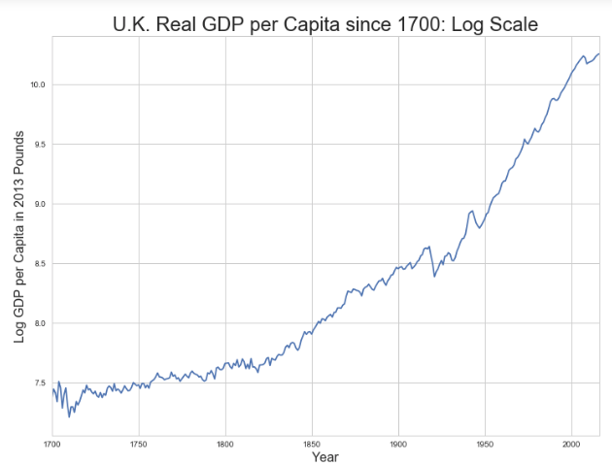
Skipped Topic: Passing the Baton: From Britain to America
The Industrial Revolution took place in Britain
The standard explanation four or five largely independent strands coming together.:
Limited government, security of property, and freedom of contract
Science and the technological tradition of sustained inquiry
Victory in the wars of the Commercial Revolution era
Machinery making, "tinkering", and "gadgets"—primarily made out of metal.
Coal in Britain—the only thing that made a steam engine potentially profitable.
Plus high elasticity of demand for leading-sector products…
http://bradford-delong.com brad.delong@gmail.com

Slide 127
iClickers: Why Breaktrhrough?
The principal reason that the Industrial Revolution took place in late eighteenth century Britain (rather than in Sung China, or Abbasid Baghdad, or Antonine Dynasty Rome, or during the Hellenistic Age) is:
A lack of human numbers thinking about problems of production
A lack of good means of communication—e.g. printing—for diffusing information about how to solve problems of production
A lack of experience using coal as an energy source
A lack of the incentive created by high real wages leading to a strong desire to make labor more productive
None of the above/not enough information
http://bradford-delong.com brad.delong@gmail.com

Slide 128
iClicker: Why Passing the Baton
The principal reason that the twentieth century was an American rather than a second British century was:
The United States’s aggressive and enthusiastic welcome of immigrants
The United States’s focus on broad-based technical education
The United States’s extraordinary abundance of natural resources driving high real wages and enormous incentives to build machines to manipulate matter
A U.S. government that took industrial development as a key policy goal, rather than being comfortable with laissez-faire
None of the above/not enough information
http://bradford-delong.com brad.delong@gmail.com

Slide 129
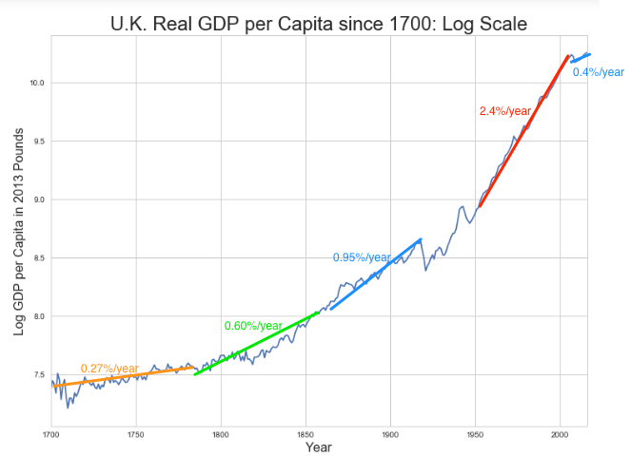
British Productivity Growth Acceleration
http://bradford-delong.com brad.delong@gmail.com

Slide 130
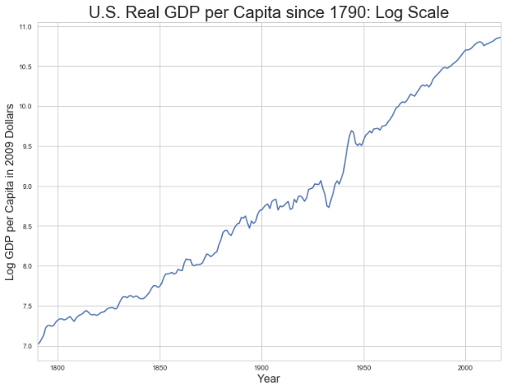
But Even in the First Half of the Nineteenth Century the U.S. Was Outpacing Britain in Growth…
Even in the first half of the nineteenth century—the period in which the British Industrial Revolution made it the wonder of the world—economic growth in the United States was proceeding faster than in Britain.
While British real GDP per capita was increasing at less than 0.6 percent per year
American was growing at a hair over one percent per year.
And a significantly larger share of GDP was going to the white working class in the United States, in the north at least:
The extraordinary abundance of land and the possibility of "lighting out for the territory", in the words of American author Mark Twain, gave even workers without property or notably scarce skills substantial economic bargaining power.
http://bradford-delong.com brad.delong@gmail.com

Slide 131
And Starting in the Late Nineteenth Century
Second Industrial Revolution…
Why the U.S. and Germany, and not Britain?
Immigration and Population
Was resource scarcity no longer a factor?
Was the differential in the growth rate h of the stock of useful economic knowledge even greater than the differential in the growth rate g of the efficiency-of-labor?
http://bradford-delong.com brad.delong@gmail.com

Slide 132
Phases of American Growth
1.0% per year in GDP per capita from 1760-1860: resource abundance
1.6% per year in GDP per capita from 1860-1929:
“Great traverse”: K/Y ratio up from 2.5 to 4
Half of it an increase in savings rates
Half of it a fall in the price of capital goods
2.5% per year in GDP per capita from 1929-1973
“Fordism”
Expected further acceleration: it did not happen
Post-1973
Productivity slowdown 1973-1995 (environment, oil, baby boom, feminism)
“New economy” 1995-2006
Post-2006 collapse of growth
http://bradford-delong.com brad.delong@gmail.com

Slide 133
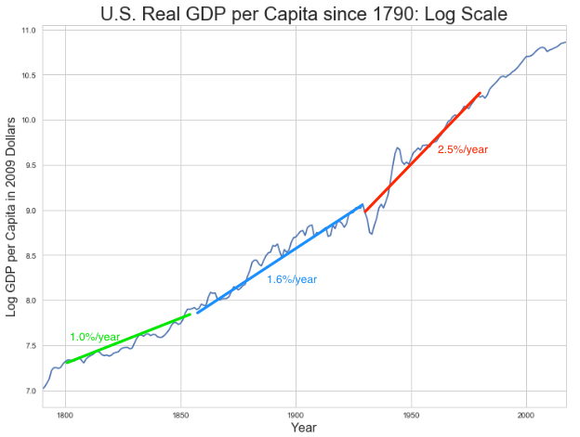
American Productivity Growth Acceleration
http://bradford-delong.com brad.delong@gmail.com

Slide 134
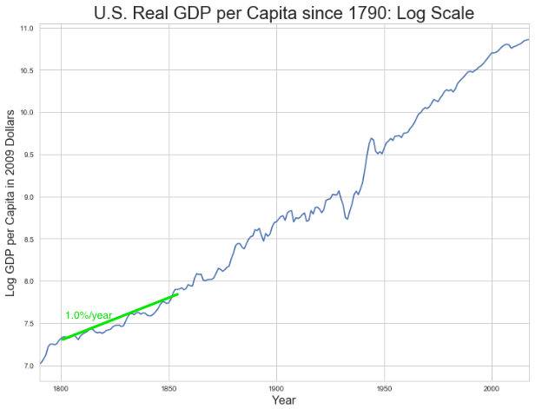
Early Nineteenth Century: Westward Expansion
Westward expansion
The “American System”
Abundant natural resources
Very high real wages
Focus on raising labor productivity
Hence fast efficiency-of-labor growth
Britain, by contrast, focused on economizing on (non-coal) raw materials
http://bradford-delong.com brad.delong@gmail.com

Slide 135
The Importance of Resources 1760-1860
Major westward expansion and "Amerindian removal”
The century 1760 to 1860 before the Civil War.
We have U.S. output-per-worker growth then at about 1.0% per year…
…in contrast to British output-per-worker growth at about 0.5% per year.
We have the U.S. population and labor force growing at 2.5% per year…
…from 2.5 to 30 million.
http://bradford-delong.com brad.delong@gmail.com

Slide 136
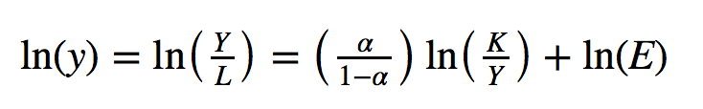
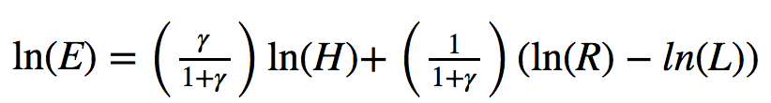
The Importance of Resources 1760-1860
Recall our basic Solow Model:
http://bradford-delong.com brad.delong@gmail.com

Slide 137
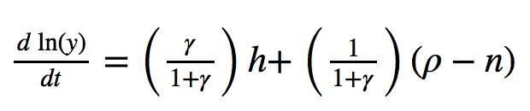
The Importance of Resources 1760-1860
Recall our basic Solow Model:
Assume K/Y constant, so the growth rate g of the efficiency of labor and the growth rate of output-per-worker are the same:
http://bradford-delong.com brad.delong@gmail.com

Slide 138
The Importance of Resources 1760-1860
Recall our basic Solow Model:
Assume K/Y constant, so the growth rate g of the efficiency of labor and the growth rate of output-per-worker are the same:
http://bradford-delong.com brad.delong@gmail.com

Slide 139
The Importance of Resources 1760-1860
Recall our basic Solow Model:
Assume K/Y constant, so the growth rate g of the efficiency of labor and the growth rate of output-per-worker are the same:
Let’s, last, fit this to history in the century before the 1860 election of President Abraham Lincoln and the ensuing American Civil War:
http://bradford-delong.com brad.delong@gmail.com

Slide 140
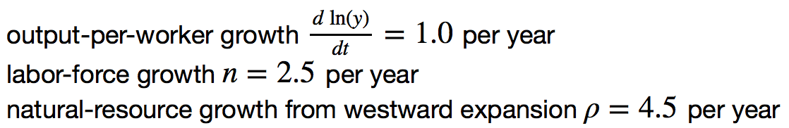
The Importance of Resources 1760-1860
Recall our basic Solow Model:
Assume K/Y constant, so the growth rate g of the efficiency of labor and the growth rate of output-per-worker are the same:
Let’s, last, fit this to history in the century before the 1860 election of President Abraham Lincoln and the ensuing American Civil War:
http://bradford-delong.com brad.delong@gmail.com

Slide 141
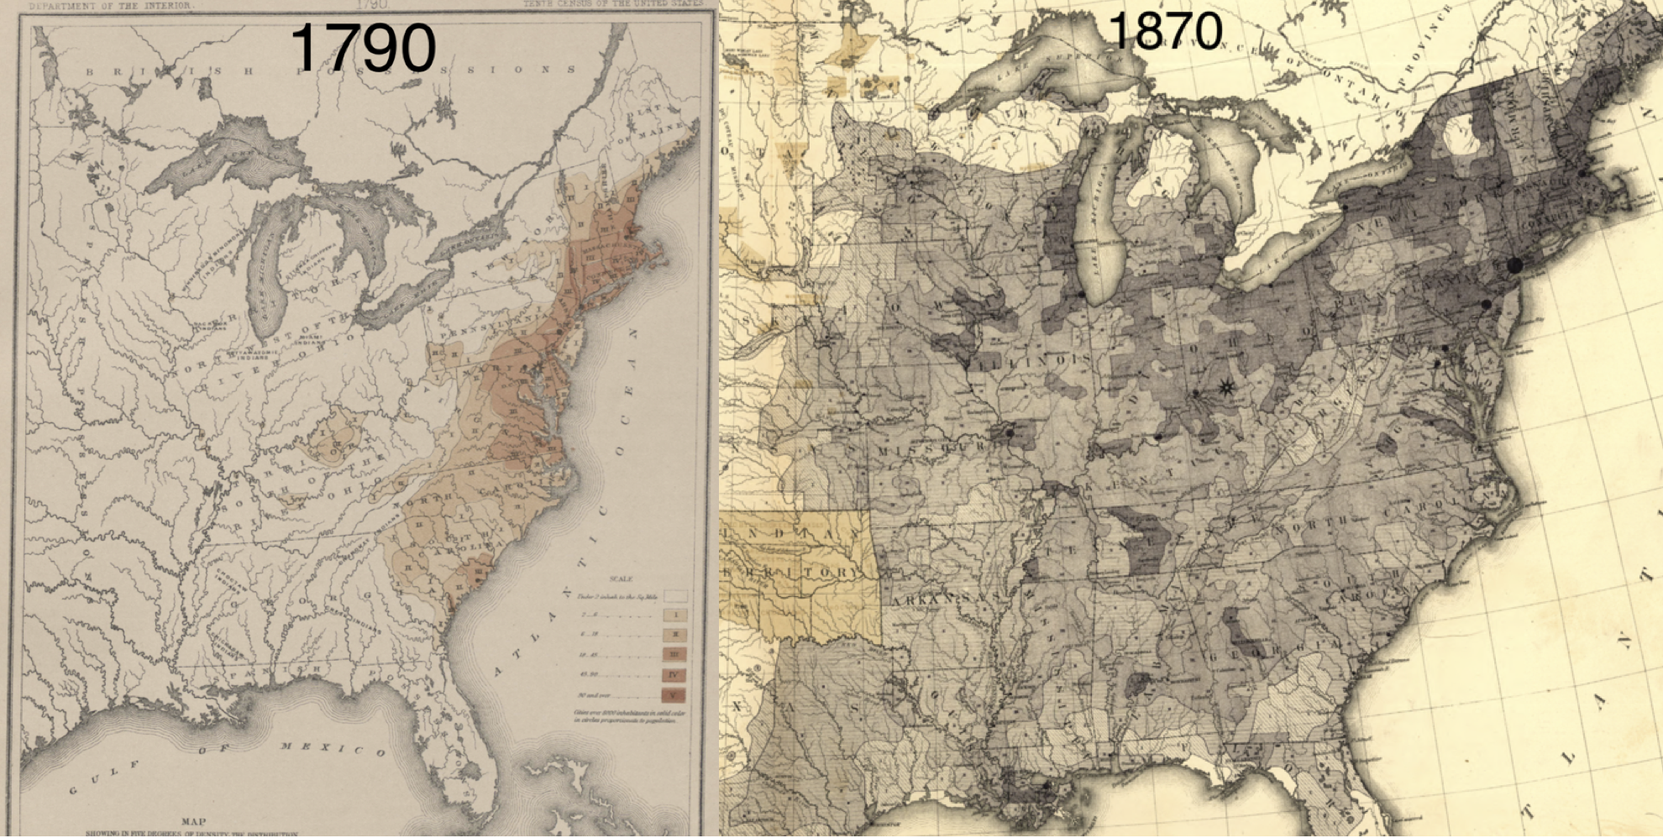
Westward Expansion
http://bradford-delong.com brad.delong@gmail.com

Slide 142
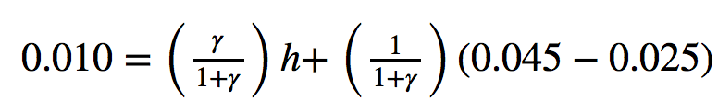
The Importance of Resources 1760-1860
We have two parameters left: γ and h, the weight of ideas in efficiency-of-labor growth and the rate of growth of the stock of useful ideas for the economy in American heads, respectively:
http://bradford-delong.com brad.delong@gmail.com

Slide 143
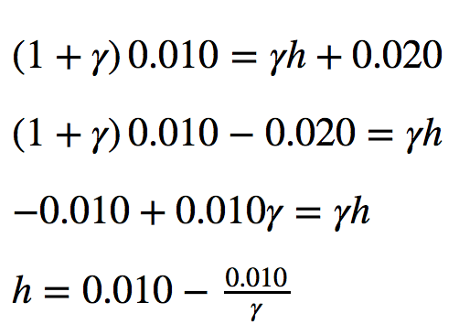
The Importance of Resources 1760-1860
We have two parameters left: γ and h, the weight of ideas in efficiency-of-labor growth and the rate of growth of the stock of useful ideas for the economy in American heads, respectively:
http://bradford-delong.com brad.delong@gmail.com

Slide 144
The Importance of Resources 1760-1860
Thus if γ→∞ then h→0.010
http://bradford-delong.com brad.delong@gmail.com

Slide 145
The Importance of Resources 1760-1860
Thus if γ→∞ then h=0.010
Thus if γ=3.0 then h=0.00667
http://bradford-delong.com brad.delong@gmail.com

Slide 146
The Importance of Resources 1760-1860
Thus if γ→∞ then h=0.010
Thus if γ=3.0 then h=0.00667
Thus if γ=1.0 then h=0.00
http://bradford-delong.com brad.delong@gmail.com

Slide 147
The Importance of Resources 1760-1860
Thus if γ→∞ then h=0.010
Thus if γ=3.0 then h=0.00667
Thus if γ=1.0 then h=0.00
Looking across the Atlantic Ocean to Great Britain, we see that over there it is indeed the case that h=0.005 from 1760 to 1860. Faster growth of h in America due to some catchup with the world's first and leading industrial nation seems likely. So γ=3.0 has some claim to be the most likely value…
http://bradford-delong.com brad.delong@gmail.com

Slide 148
A Counterfactual
The Royal Proclamation of October 1763:
Our Royal Will and Pleasure… no... Governor or Commander in Chief in... our... Colonies or Plantations in America do... grant Warrants of Survey, or pass Patents for any Lands beyond the Heads or Sources of any of the Rivers which fall into the Atlantic Ocean from the West and North West, or upon any Lands whatever, which, not having been ceded to or purchased by Us as aforesaid, are reserved to the said Indians, or any of them...
http://bradford-delong.com brad.delong@gmail.com

Slide 149
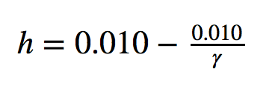
What If This Royal Proclamation Had Stuck?
What if ρ=0?
If γ → ∞ and h=0.010 then g=0.01
If γ=3.0 and h=0.00667 then g=−0.00125
If γ=1.5 and h=0.000 then g=−0.01
http://bradford-delong.com brad.delong@gmail.com

Slide 150
What If This Royal Proclamation Had Stuck?
What if ρ=0?
If γ → ∞ and h=0.010 then g=0.01
If γ=3.0 and h=0.00667 then g=−0.00125
If γ=1.5 and h=0.000 then g=−0.01
An America penned behind the Appalachians would probably have seen its living standards and productivity levels not growing at 1% per year from 1760 to 1860 but shrinking.
For γ=3.0, living standards and productivity levels would have shrunk at a pace of -0.125% per year
http://bradford-delong.com brad.delong@gmail.com

Slide 151
What If This Royal Proclamation Had Stuck?
What if ρ=0?
Of course, a poorer America would probably have seen fewer immigrants.
But it might not have seen that many fewer immigrants.
It would no longer have been quite as attractive to move from Britain to America over 1760 to 1860.
But it still would have been very attractive to move from France, Germany, Scotland—or most of all from Potato Blight-ridden Ireland...
In what other ways might this counterfactual alternate-history "little America" would likely have been different in 1860 than America actually was?
http://bradford-delong.com brad.delong@gmail.com

Slide 152
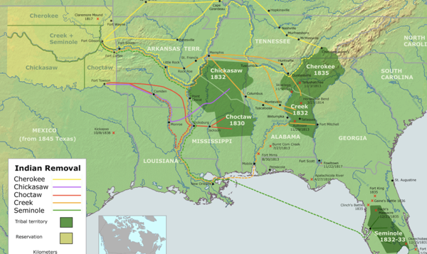
“Trail of Tears’
http://bradford-delong.com brad.delong@gmail.com

Slide 153
A large chunk of America's pre-1860 visible growing prosperity was based not just on African-American slavery, but also on "Amerindian removal"
http://bradford-delong.com brad.delong@gmail.com

Slide 154
Catch Our Breath…
Ask me two questions…
Make two comments…

Slide 155

Late Nineteenth-Early Twentieth Century: “Great Traverse”
Invention of the industrial research lab
First globalization
Technologies of Second Industrial Revolution
Economies of scale and mass production
Falling price of capital goods
Greater savings effort
Plus mass immigration
Rapidly rising inequality
Or was it? Emancipation…
http://bradford-delong.com brad.delong@gmail.com

Slide 156
Capital Deepening
Lowered deprecation rate δ
From 5% to 3% per year
http://bradford-delong.com brad.delong@gmail.com

Slide 157
Capital Deepening
Lowered deprecation rate δ
From 5% to 3% per year
Increased savings rate s
Capital-output ratio goes from 2.5 to 4 across 70 years
http://bradford-delong.com brad.delong@gmail.com

Slide 158
Capital Deepening
Lowered deprecation rate δ
From 5% to 3% per year
Increased savings rate s
Capital-output ratio goes from 2.5 to 4 across 70 years
with an α=1, output-per-worker proportional to the capital-output ratio
ln(4/2.5)/70 = 0.007
g = 0.9%/year
http://bradford-delong.com brad.delong@gmail.com

Slide 159
Capital Deepening
Capital-output ratio goes from 2.5 to 4 across 70 years
with an α=1, output-per-worker proportional to the capital-output ratio
ln(4/2.5)/70 = 0.007
g = 0.9%/year
Second Industrial Revolution
Large managerial corporation
Large-scale investment banking
Industrial research lab
Continent-wide market
Globalization
http://bradford-delong.com brad.delong@gmail.com

Slide 160

Mid Twentieth Century: Drive to High Mass Consumption
DARPA, etc.: two heads are better than one
“Fordist” oligopolies
Second globalization
Keynesian stabilization policies
Falling and then low inequality
For white guys…
http://bradford-delong.com brad.delong@gmail.com

Slide 161
Mid Twentieth Century: Drive to High Mass Consumption
DARPA, etc.: two heads are better than one
“Fordist” oligopolies
Second globalization
Keynesian stabilization policies
Falling and then low inequality
For white guys…
http://bradford-delong.com brad.delong@gmail.com

Slide 162
Catch Our Breath…
Ask me two questions…
Make two comments…

Slide 163
Notes

